Slide 1
foamStar solver advancement on non naval application
Sithik Aliyar^{(1,2)}
⁽¹⁾Ecole Centrale Nantes
⁽²⁾Indian Institute of Technology, Madras

Slide 2
OUTLINE
Problem Description
Hydrostatics
Free decay
Heave Free Decay
Pitch Free Decay
Surge Free Decay
Regular Wave Interaction
Irregular Wave stand
MoorDyn Progress

Slide 3
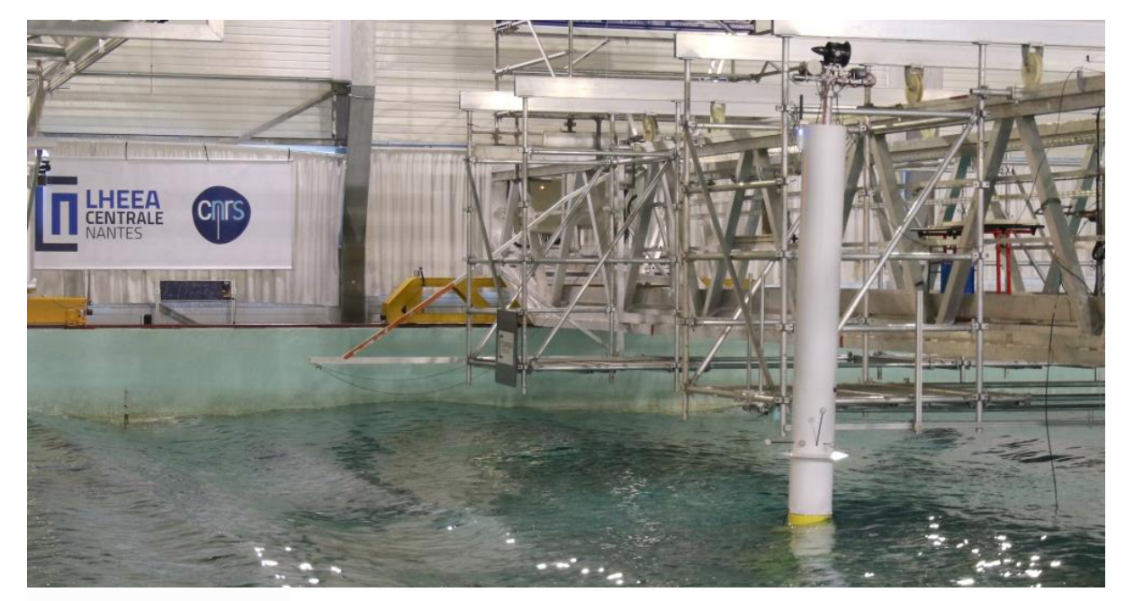
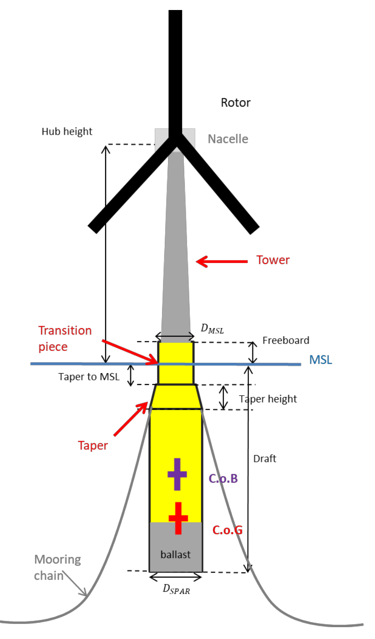
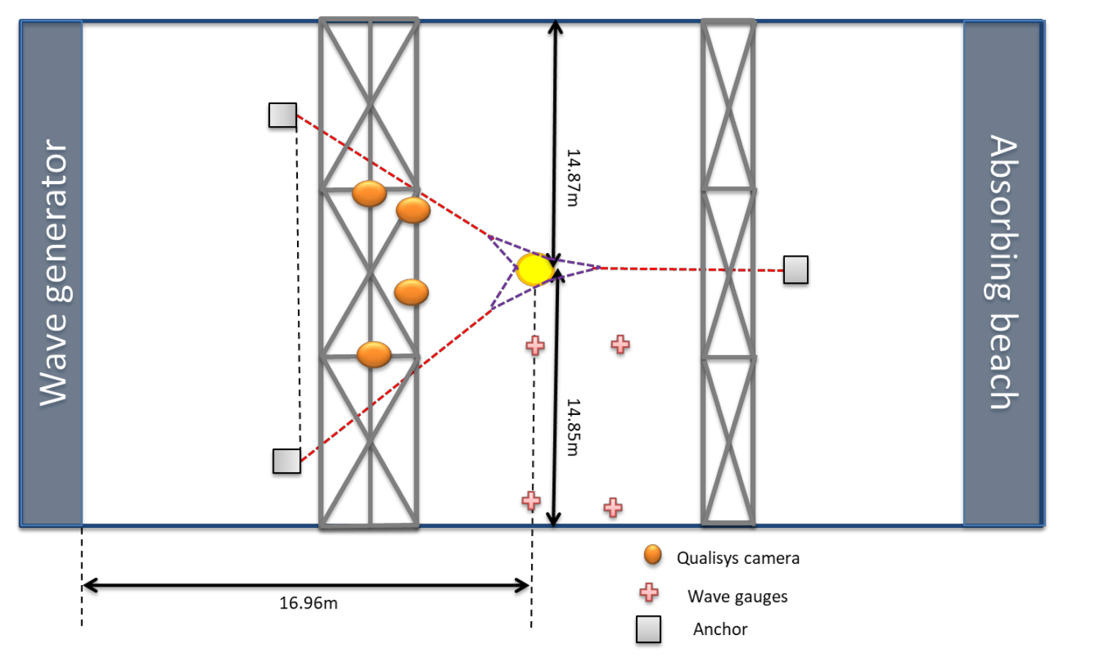
ECN Experiment (Vincent et al 2020)
Floating Offshore Wind Turbine with SPAR floater in multi- segmented Catenary mooring system
TestCases carried in Experiment
Decay tests
Decay tests with waves
Regular waves without wind
Motion RAO
Wave drift forces
Regular waves with speed
Motion RAO
Wave drift forces
Irregular waves and turbulent wind
Properties | Values
Mass (Floater + Tower+ Hub) | 329.73 kg
COG (calculated) | (-0.0043,0,-1.8055)
MOI (calculated) | 190,190,10 (kgm²)
COB | -1.023

Slide 4
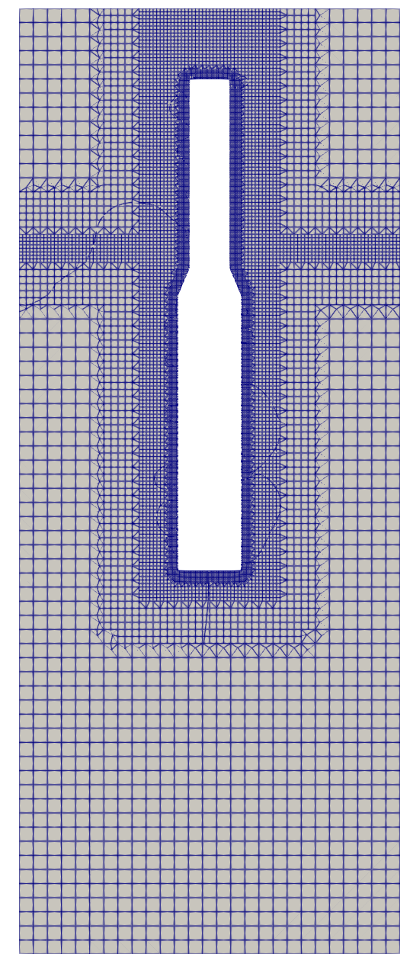
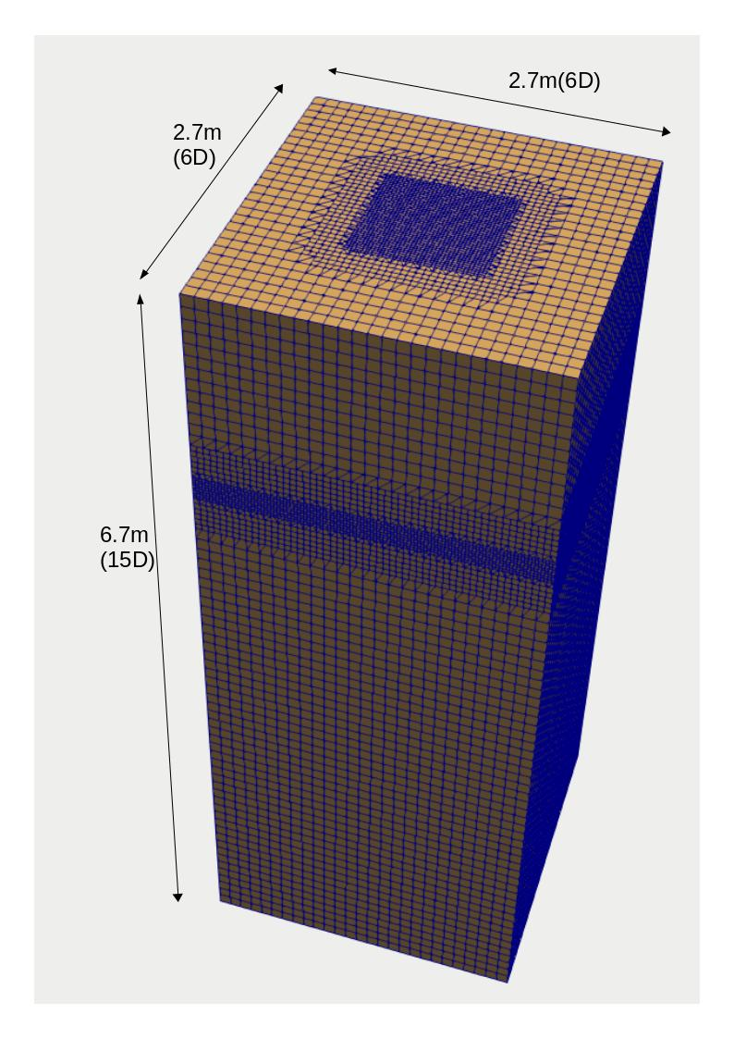
Computational Domain
Experiment was carried with wave basin with water depth of 5m
To study the influence of Free Decay/Hydrostatics - Domain of influence required is small
Chosen Domain around the SPAR is 6D X 6D X 15D ( D- $D_{SPAR}$ - Diameter of SPAR - 0.45m)
Influence of relaxation zone is verified to see the efficiency of the domain
Fig: Computational domain around the SPAR
Fig: Mesh generated for SPAR

Slide 5
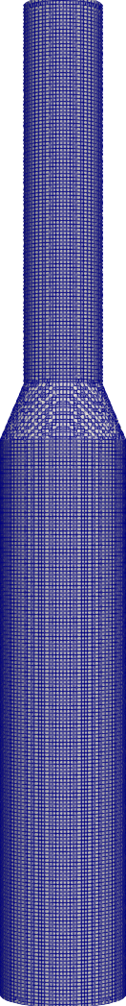
SPAR Mesh Generation and efficiency
2
Stl file generated from SALOME
Meshing carried out using snappyHexMesh utility
Meshing in Snappy Hex Mesh involves refinement in BlockMesh and Snappy HexMesh
Refinement Box 1 and 2 do not have any influence on Volume of SPAR
Submerged volume of SPAR is influenced by BlockMesh cells dimension, SPAR surface refinement
To evaluate the accuracy of the SPAR submerged volume - Theoretical/analytical volume is compared with the submerged volume from foamStar
1
Edge
refinement
Surface
refinement
BlockMesh
refinement
Fig: Mesh generated for SPAR

Slide 6
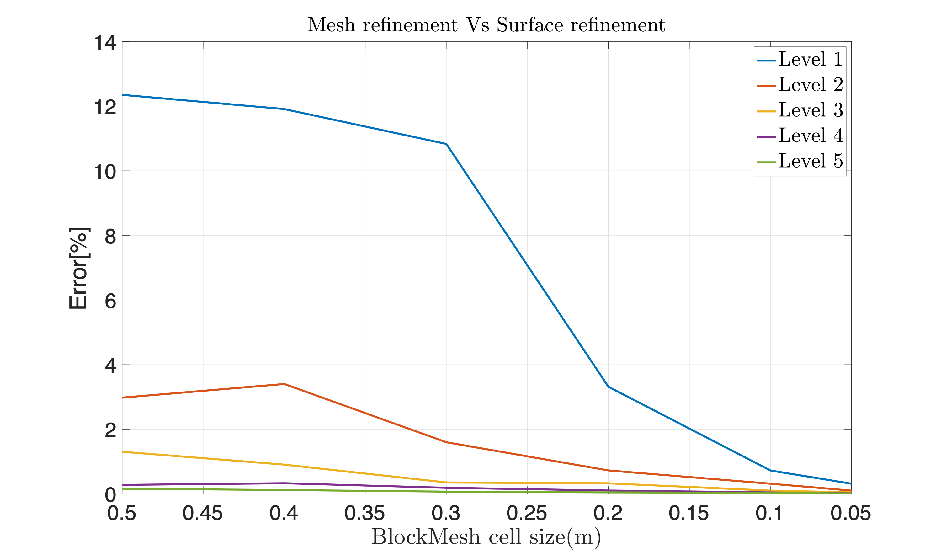
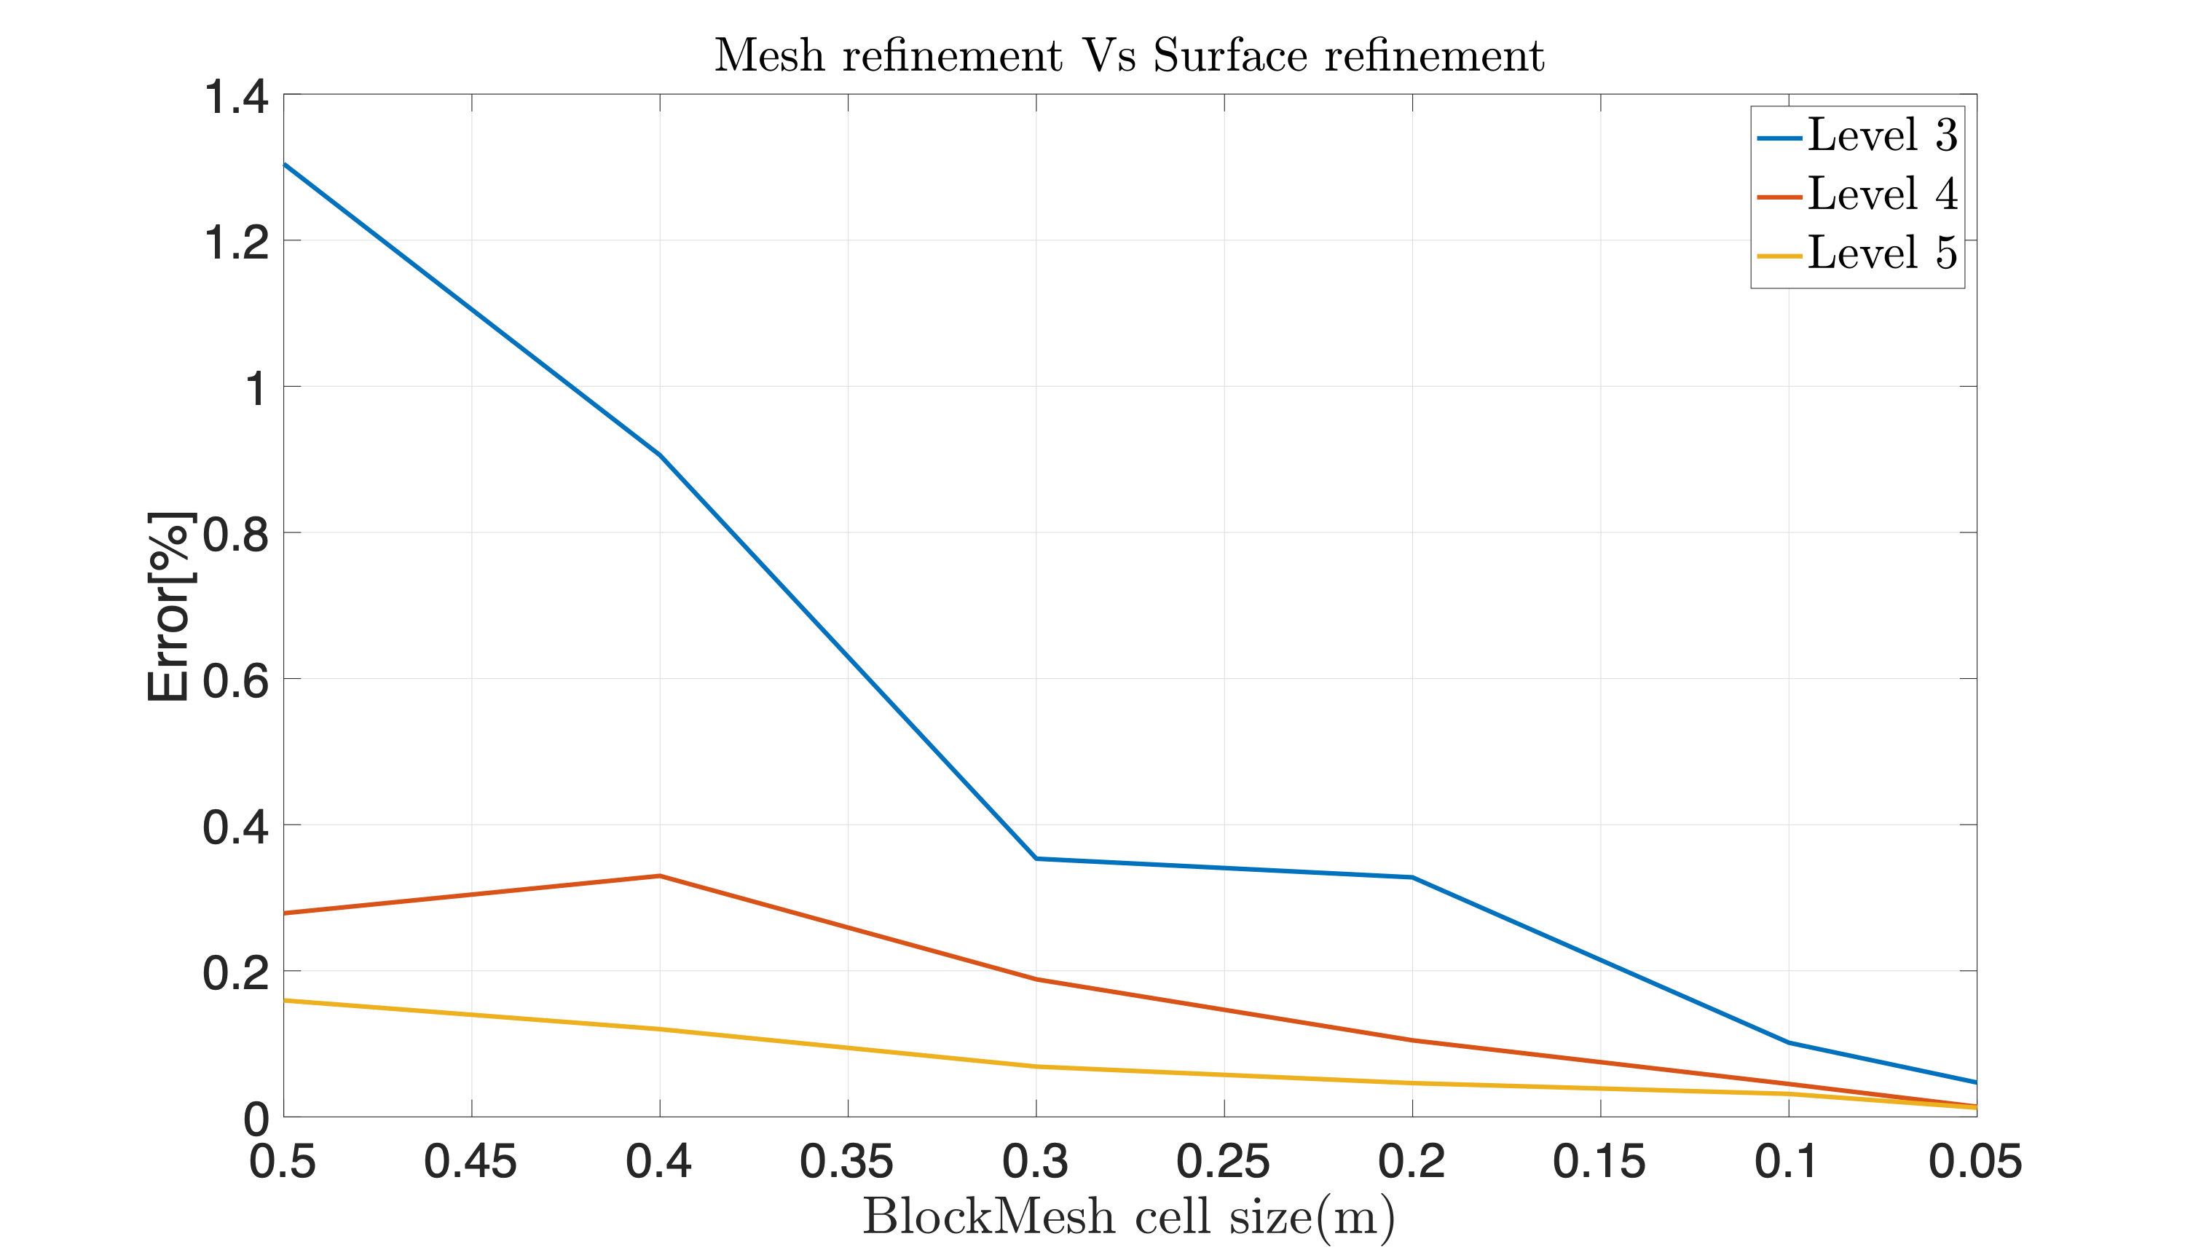
BlockMesh Vs Snappy refinement
Fig: Evaluation of accuracy of body mesh with BlockMesh cells refinement Vs SnappySurface refinement
Fig: Same (Left )figure with Only 3 levels to show the effectively
Note :
Error (%) = Theoretical submerged volume of SPAR - Meshed submerged volume of SPAR
Level 1…5 means Snappy refinement level utility in Openfoam

Slide 7
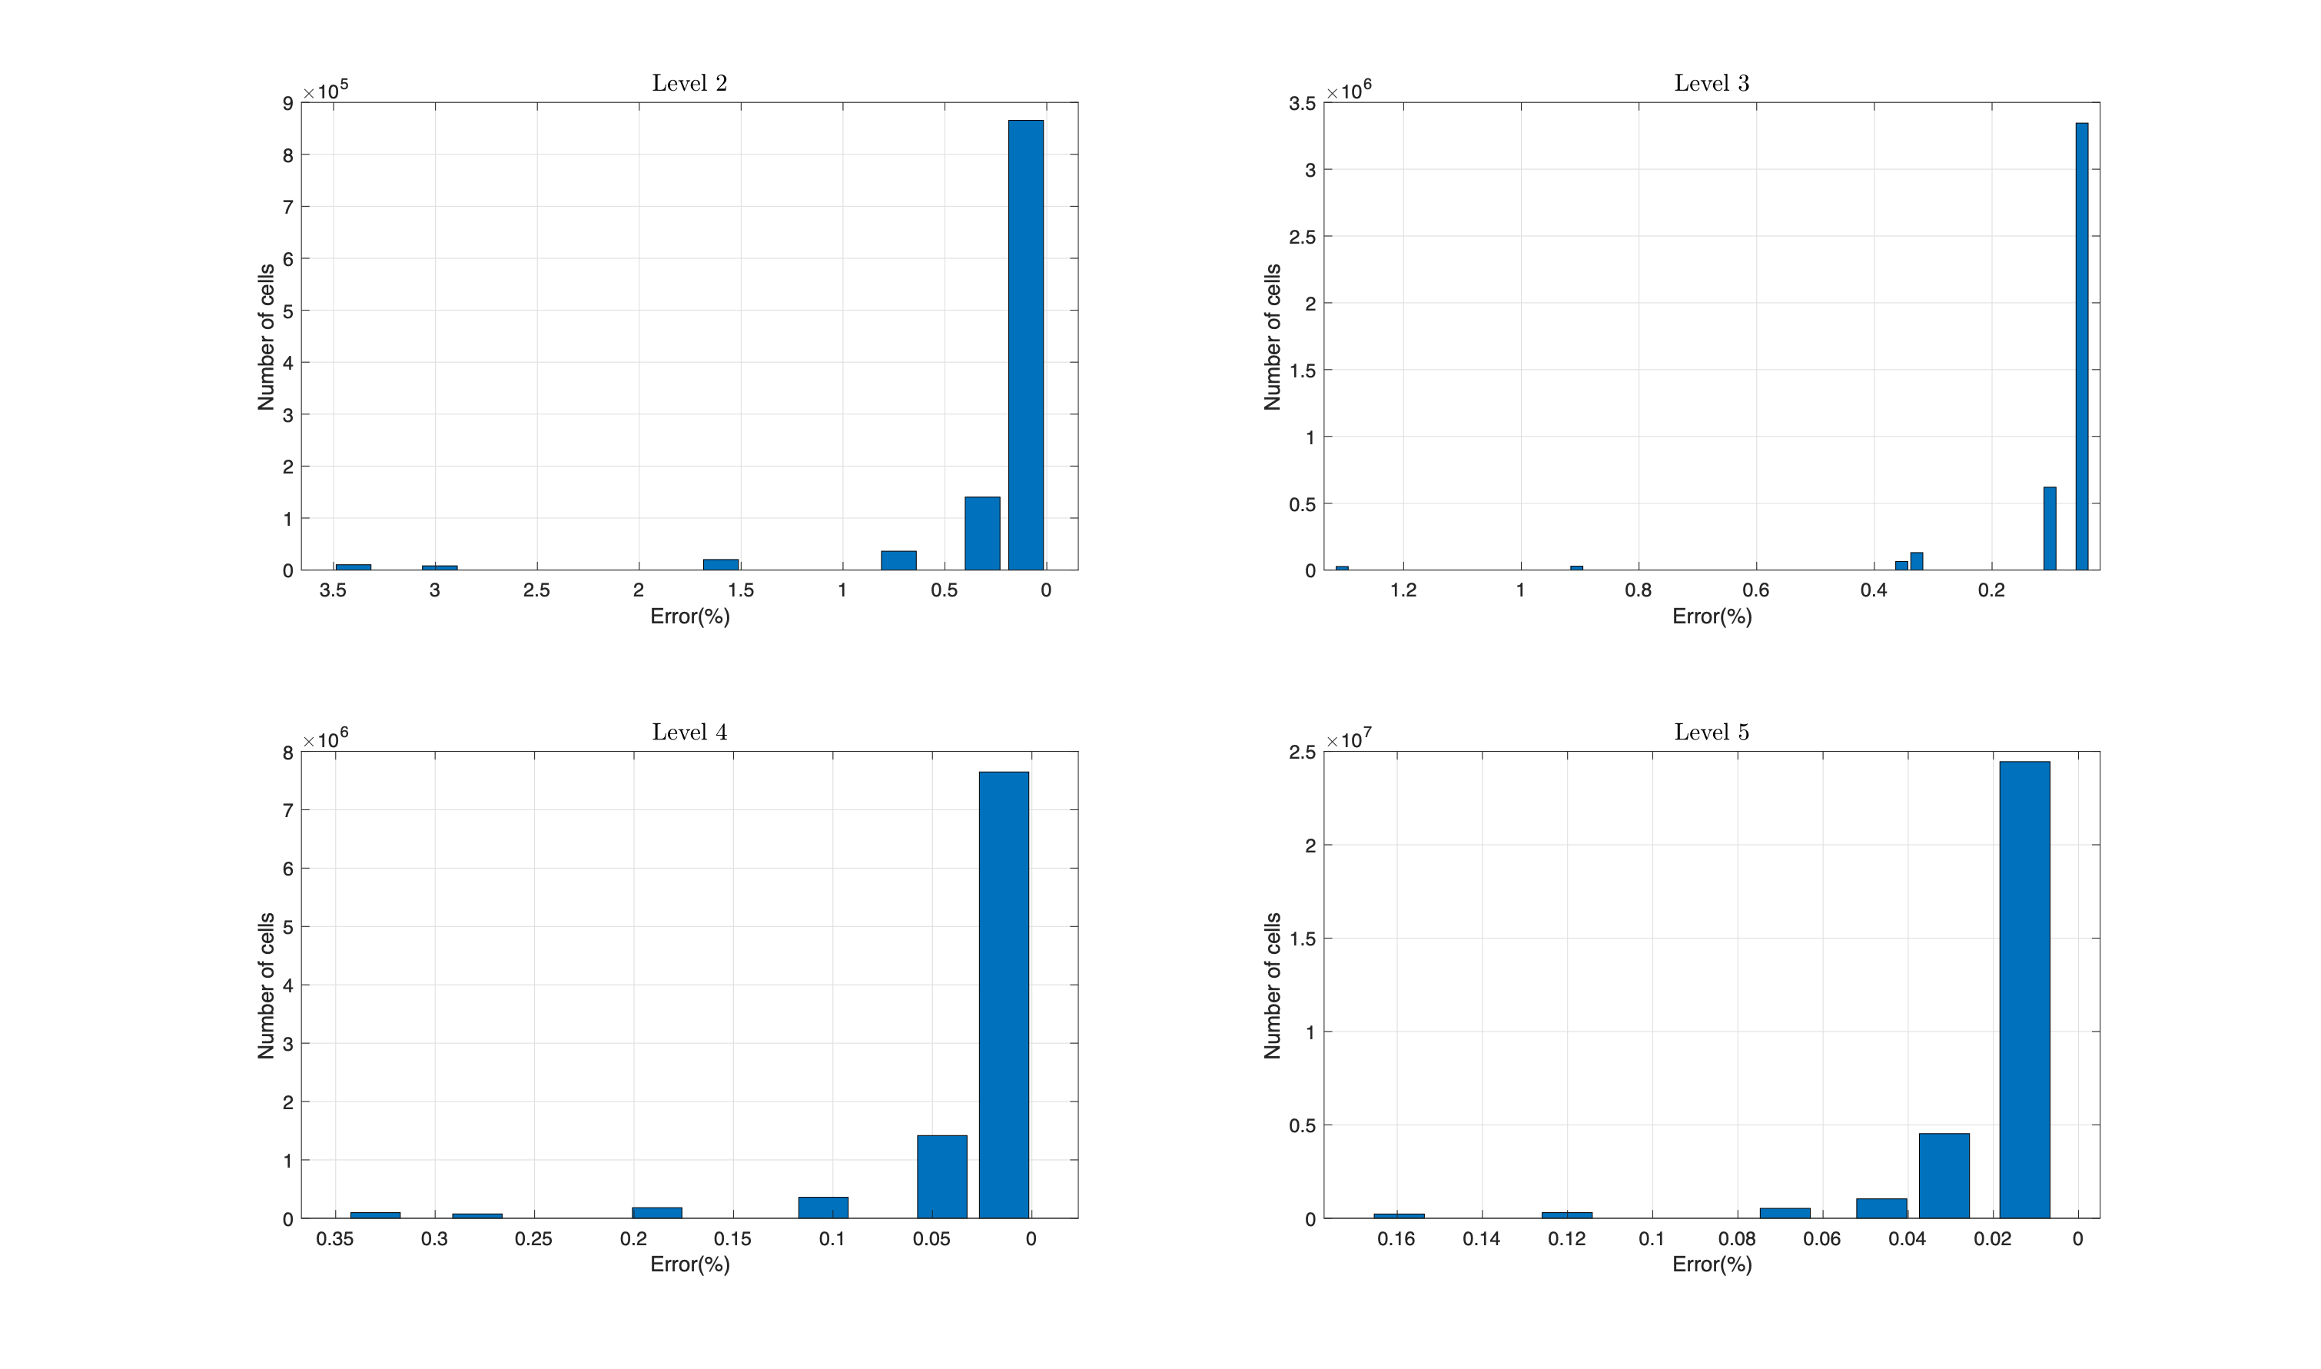
BlockMesh Vs Snappy refinement
Selecting a efficient mesh combination having less than 0.1% difference from the Theoretical SPAR volume
Another main criteria for the selection is
Efficient setup

Slide 8
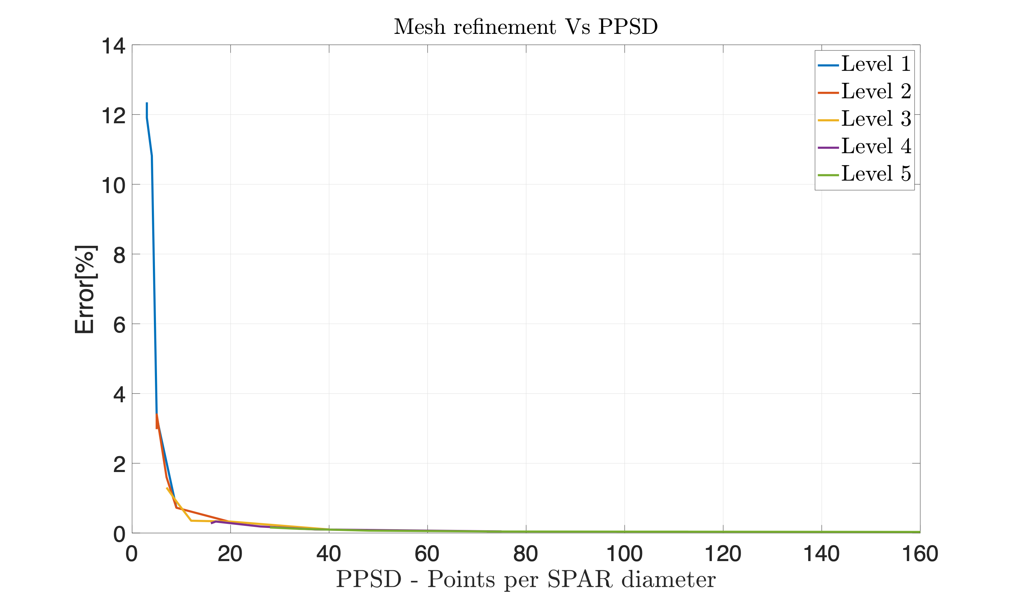
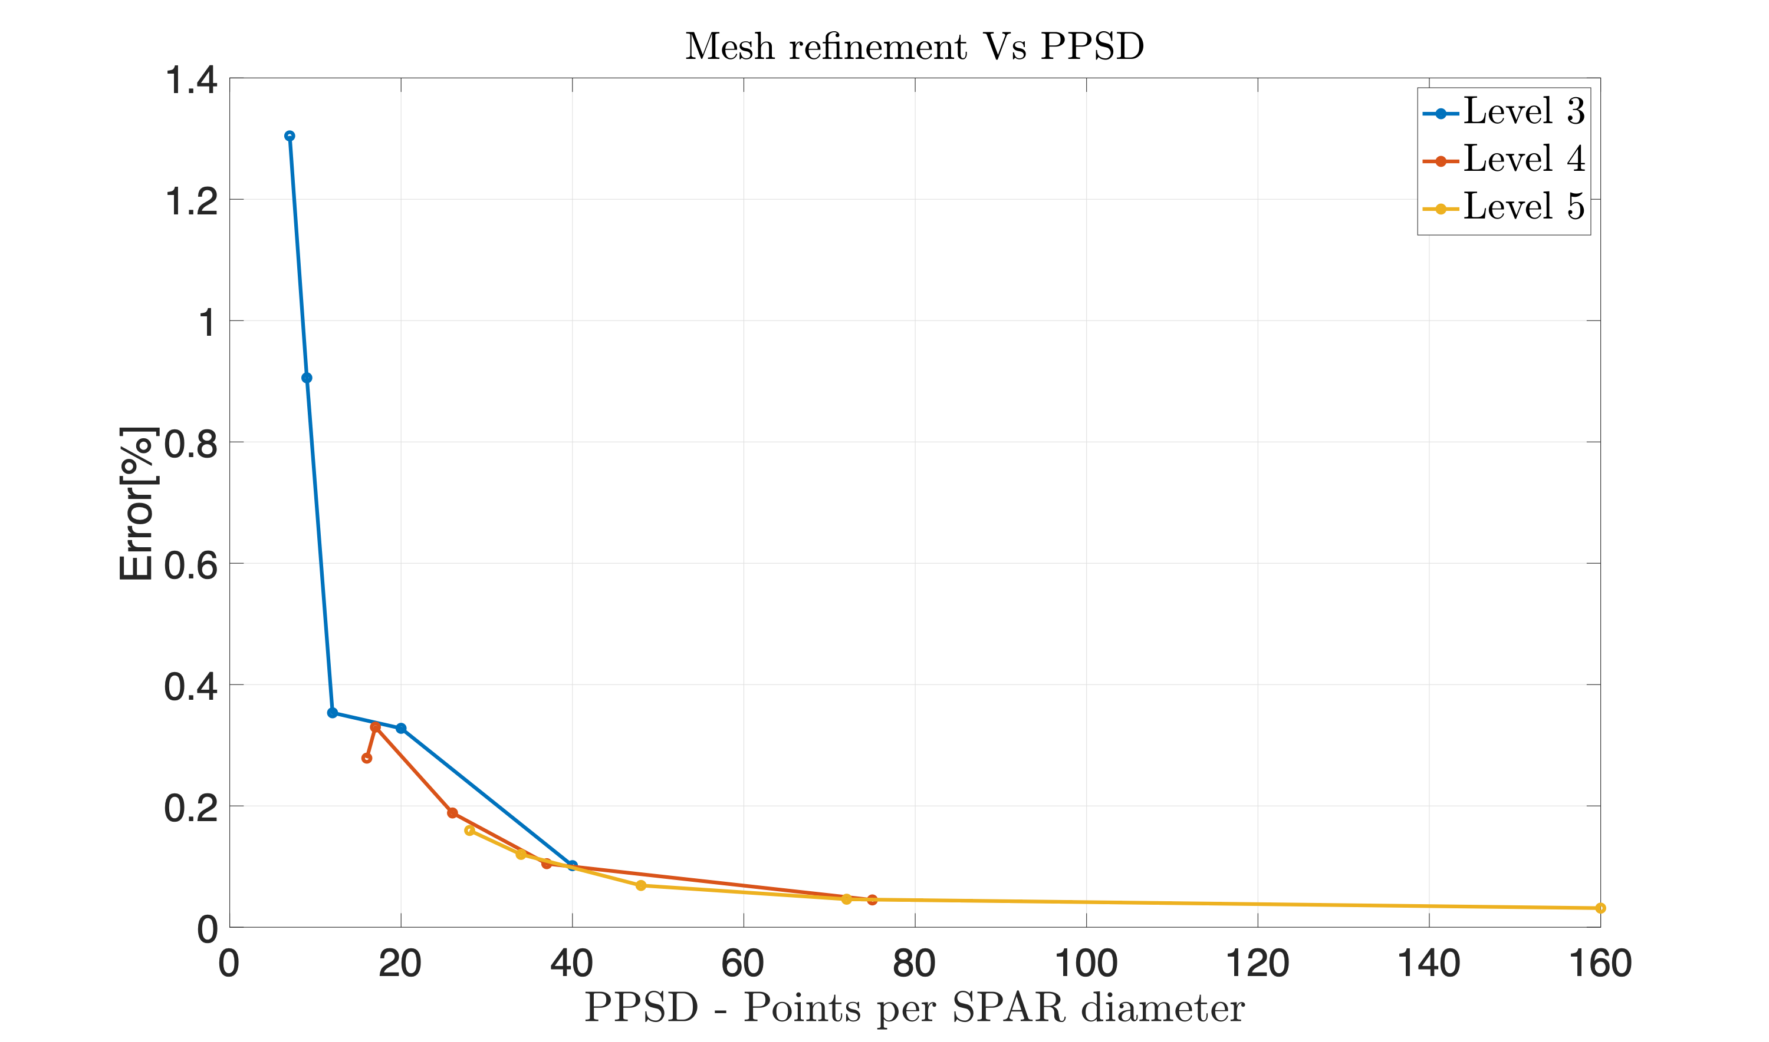
In terms of PPSD
Efficient setup
Fig: Evaluation of accuracy of body mesh with PPSD (Points per SPAR Diameter cells refinement Vs SnappySurface refinement
Fig: Same (Left )figure with Only 3 levels to show the effectively
Note : PPSD 35 is better set up - as shown earlier (as Error $≈$ 0.1% with only 0.3 million cells)- This set up will be used for other studies

Slide 9
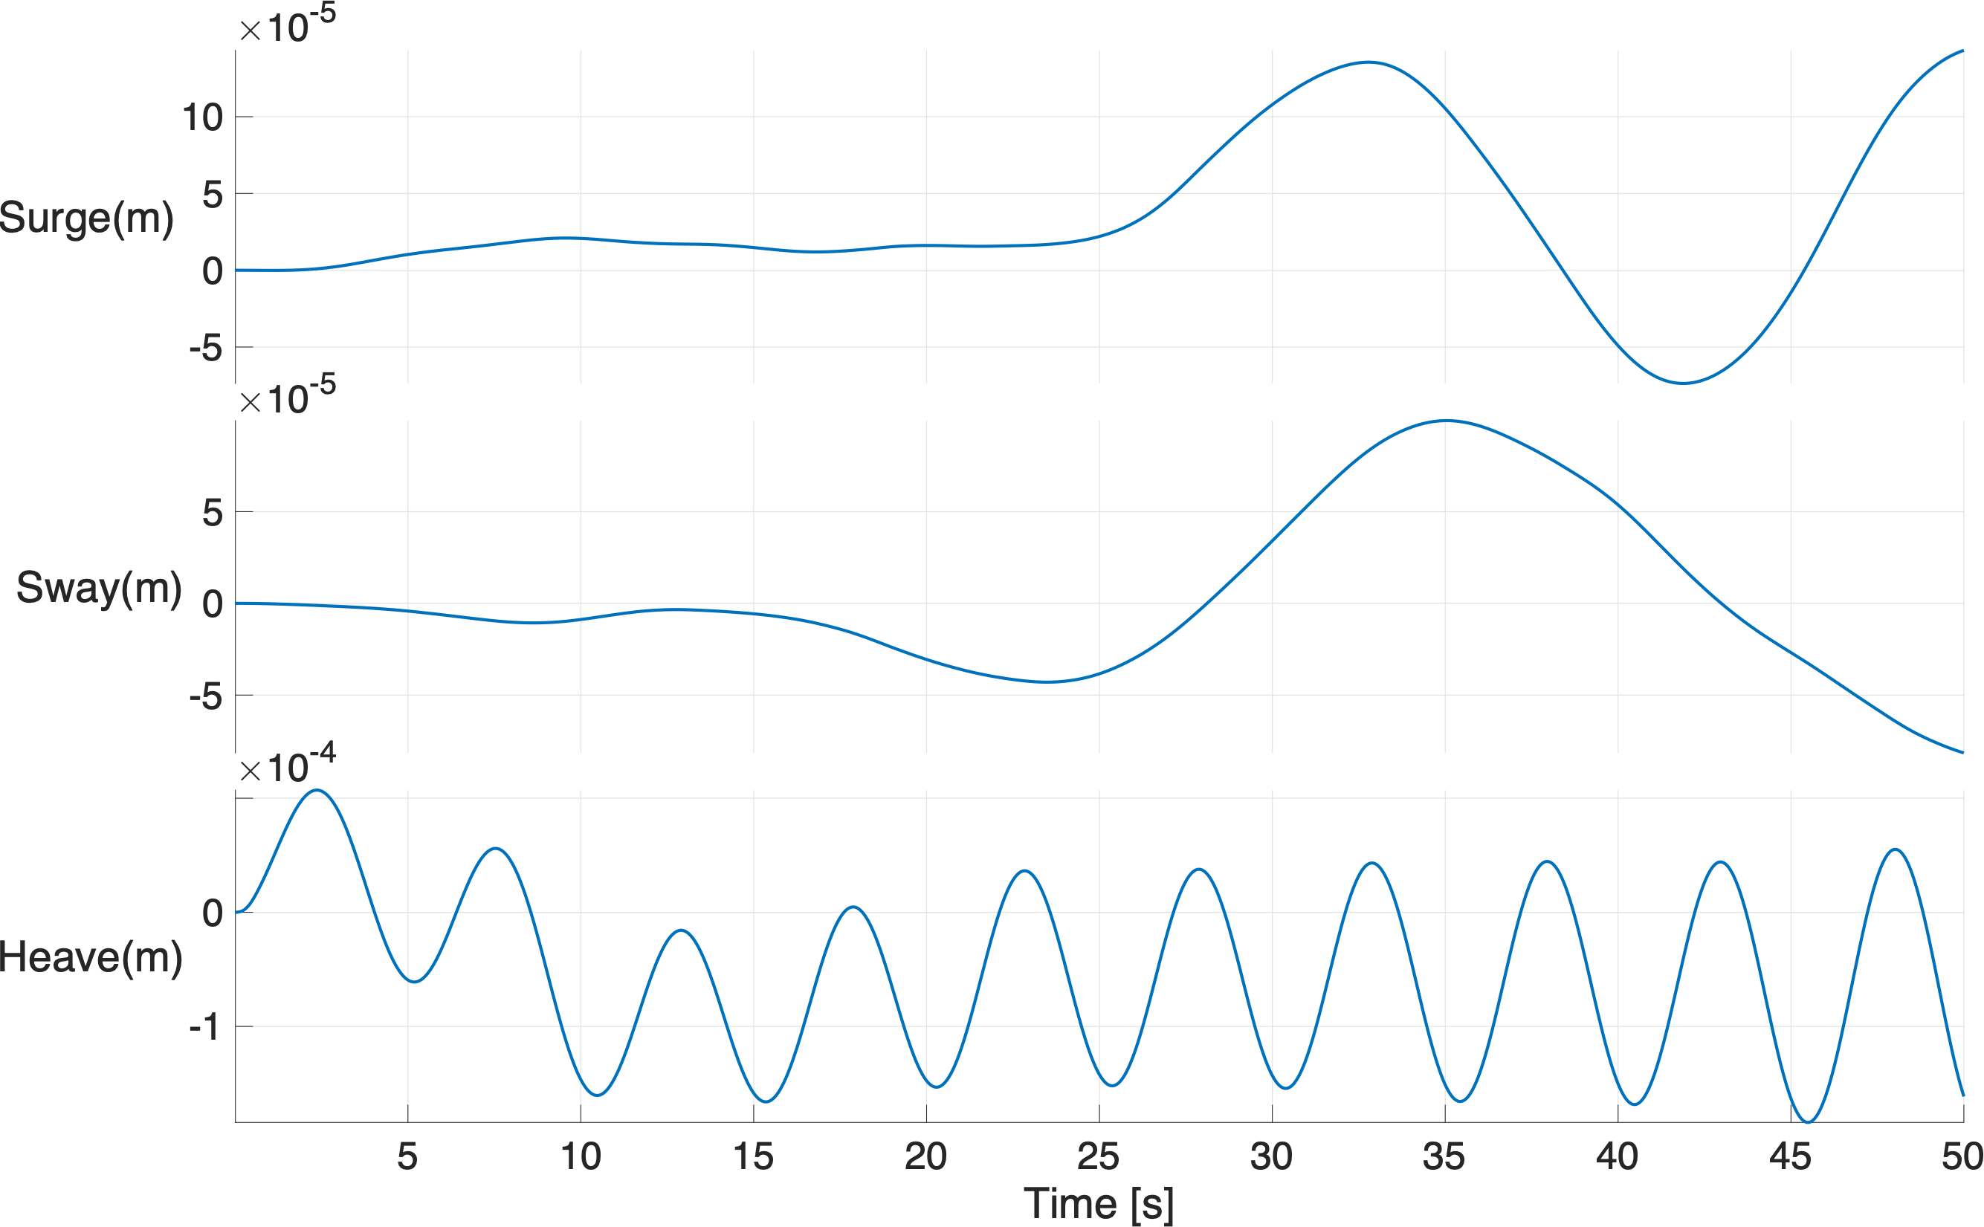
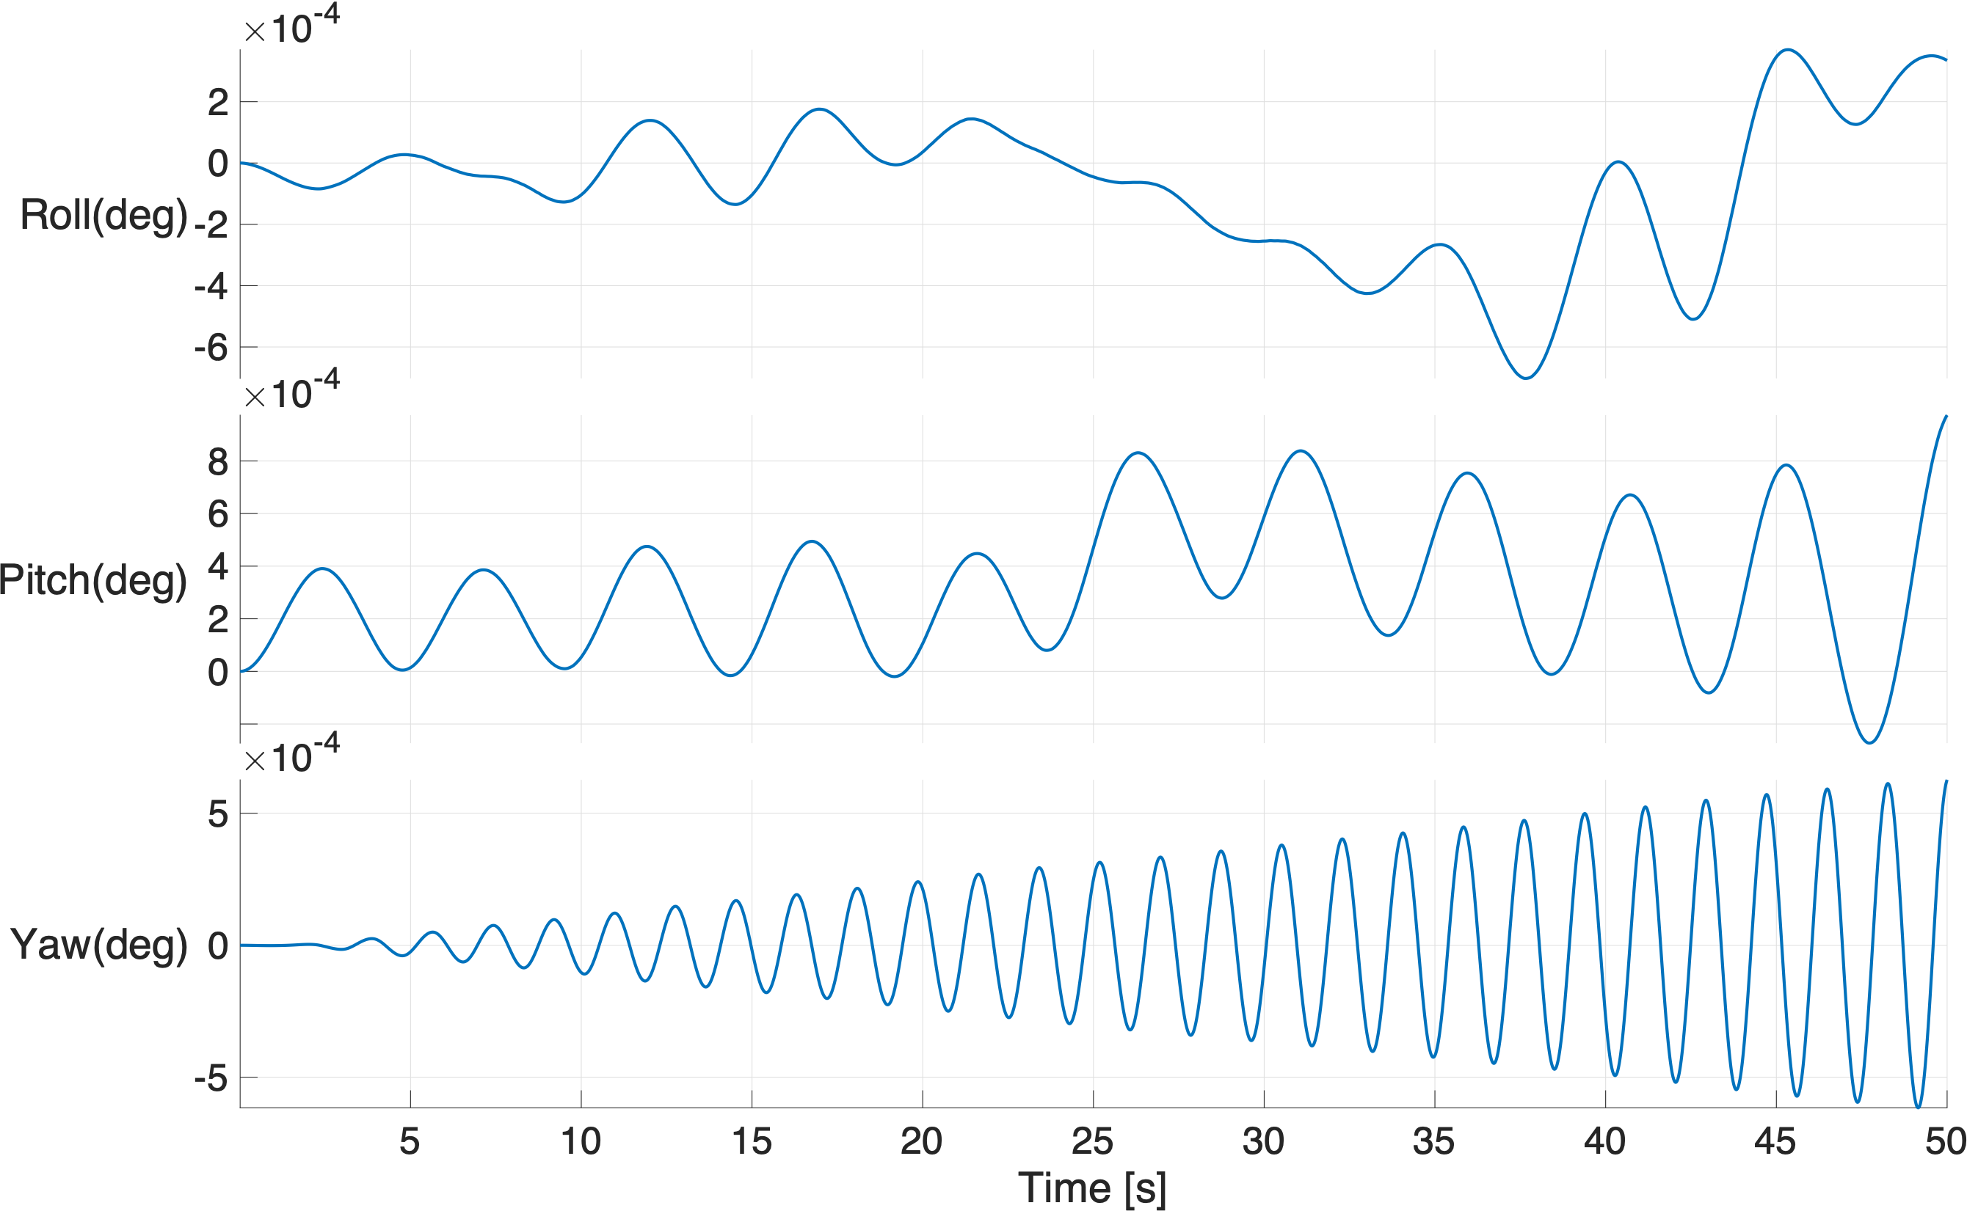
Hydrostatics
To investigate the accuracy of mass of the body being used and also the draft - Hydrostatic analysis is carried out
Catenary mooring set up is modelled as constant stiffness matrix with stiffness values obtained from the OrcaFlex
Through out this presentation- all the results are based on assuming mooring as constant stiffness matrix
From the results obtained - although motion didnt comes to rest - all the motions are in the range of <${10}^{-4}$
Hence this mesh set up will be continued with same parameters for other study

Slide 10
Heave Free Decay

Slide 11

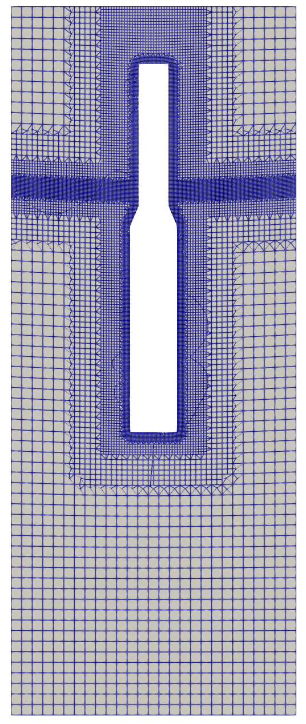
Heave Free Decay
Experiment with Heave Free Decay was carried out with initial displacement of 0.045m and for the duration of 100s until the body settles
From the Experiment results,
Experimental natural period :4.85s
Damping ratio - $1\%-2\%$
In numerical set up, same earlier set up will be used and length of simulation is planned for 4 to 5 peaks
Initial movement of 0.045m is carried out through moveDynamicMesh utility as shown in Figure and then released in fomStar (Buoyancy to do the work)
Lot of factors has been studied from Initial setup till now
Ansys AQWA model also prepared inorder to verify the foamstar/SWENSE results with potential solver also
Fig: Mesh view(at t=0) after moving the mesh as per Initial displacement

Slide 12
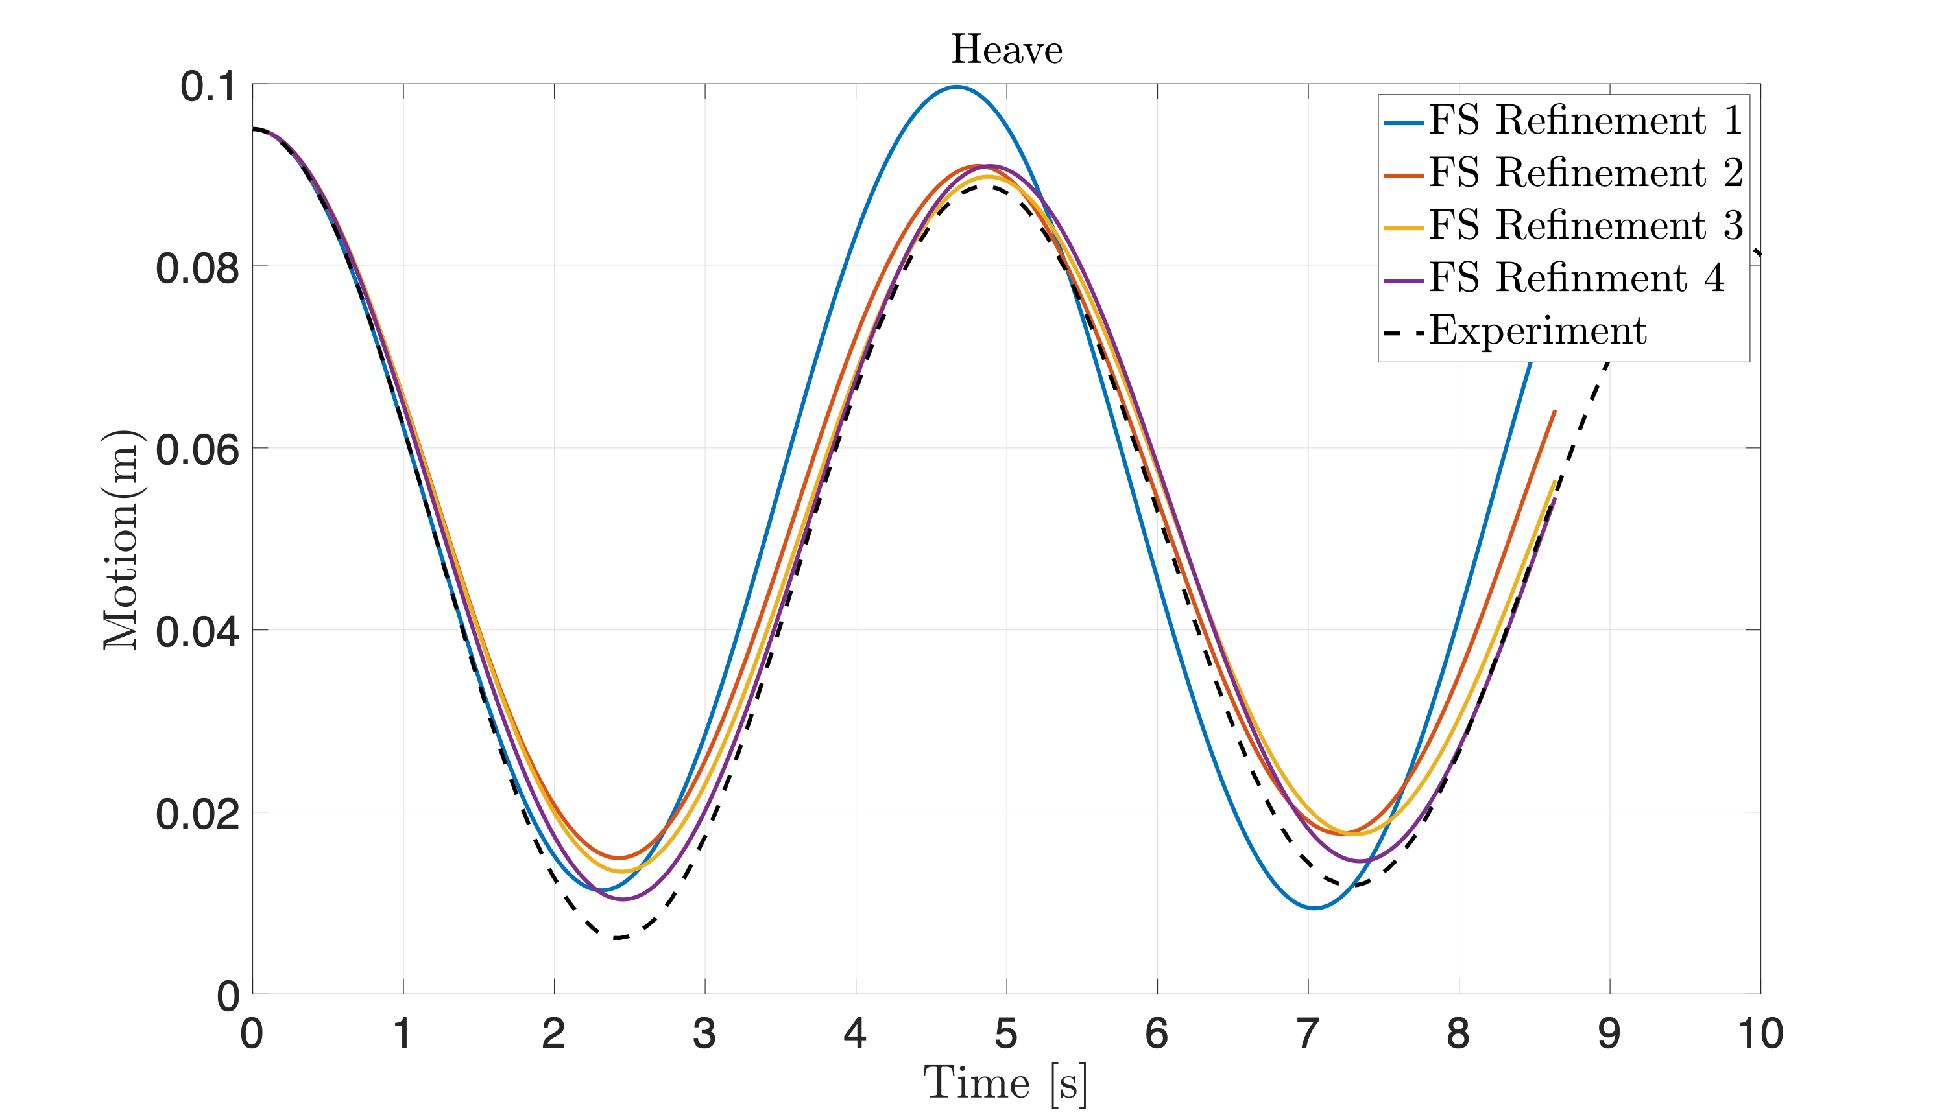
Influence of Outer Box refinement
2
Since the outer box has no influence in the PPCD - Influence of outer boxes are tested with the problem of Heave Free Decay motion
FS Refinement involved refining 1 and 2 in the same ratio
It seems that refinment has an influence on damping values obtained in the simulation (higher refinement has better results in terms of damping)
1

Slide 13
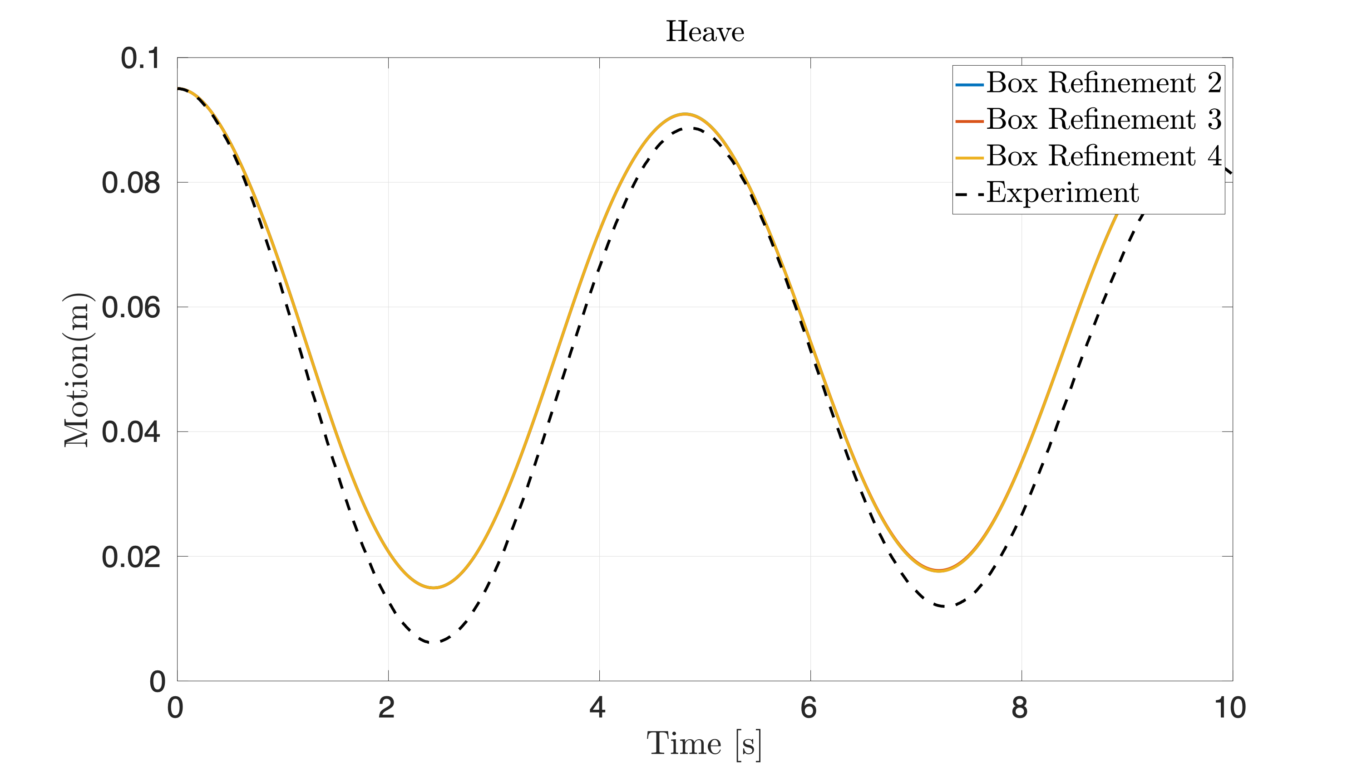
Influence of Bottom Box refinement
2
Keeping FS refinement level 2 and having bottom box (-2.15 to -2.4) - To check the influence of vortex damping in the study of damping (Mainly to verify whether bottom refinement is enough instead of whole refinement)
1
3
Parameters | Box 1 | Box 2 | Box 3
Level | 2 | 2 | Varying

Slide 14
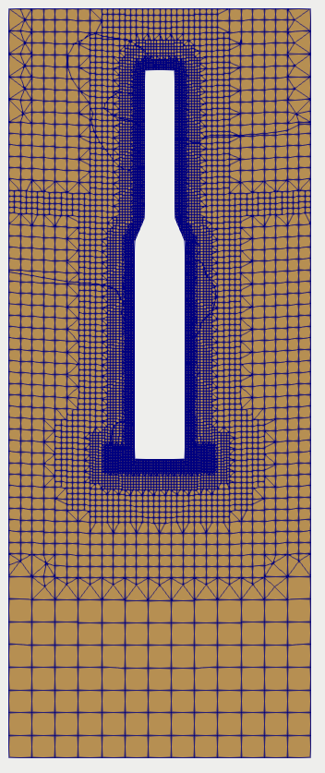
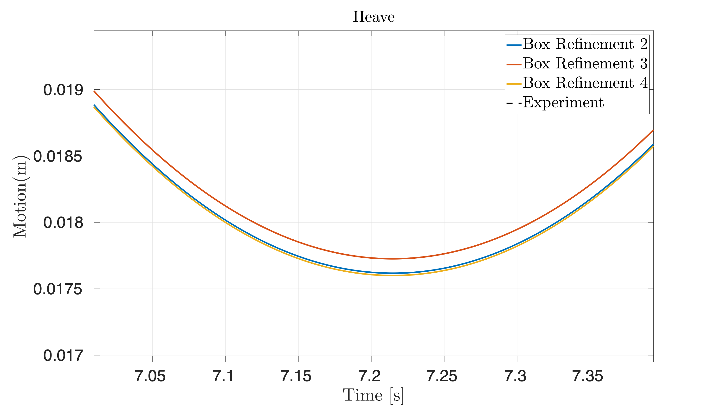
Influence of Bottom Box refinement
2
Refining the Bottom only keeping the domain constant - Only influencing the results by 1e-4 !! So no point in refining the bottom!!
1
3
Parameters | Box 1 | Box 2 | Box 3
Level | 2 | 2 | Varying

Slide 15
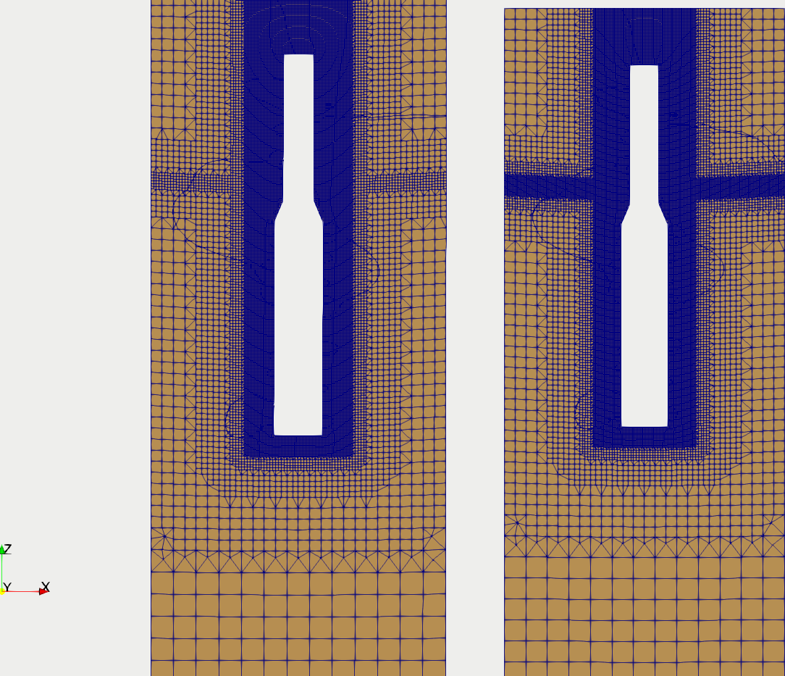
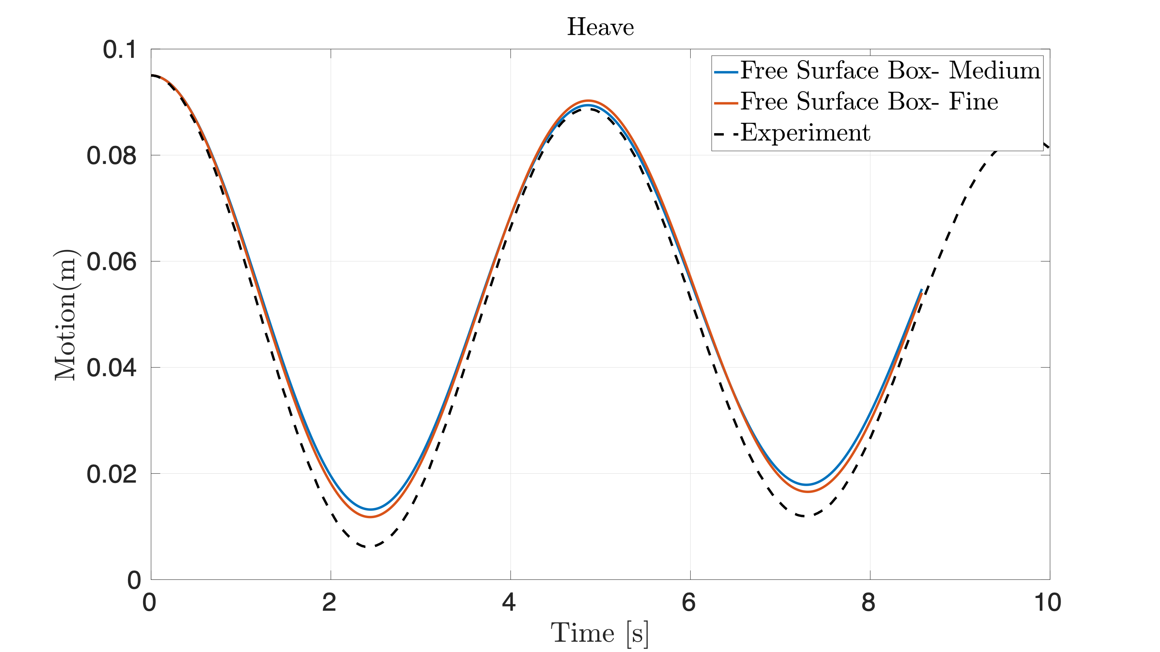
Influence of Free Surface refinement
Picking up the Level 4 refinement in outer Box and refining the Free surface to check the influence of Free surface refinement (Level 1 and Level 2)

Slide 16
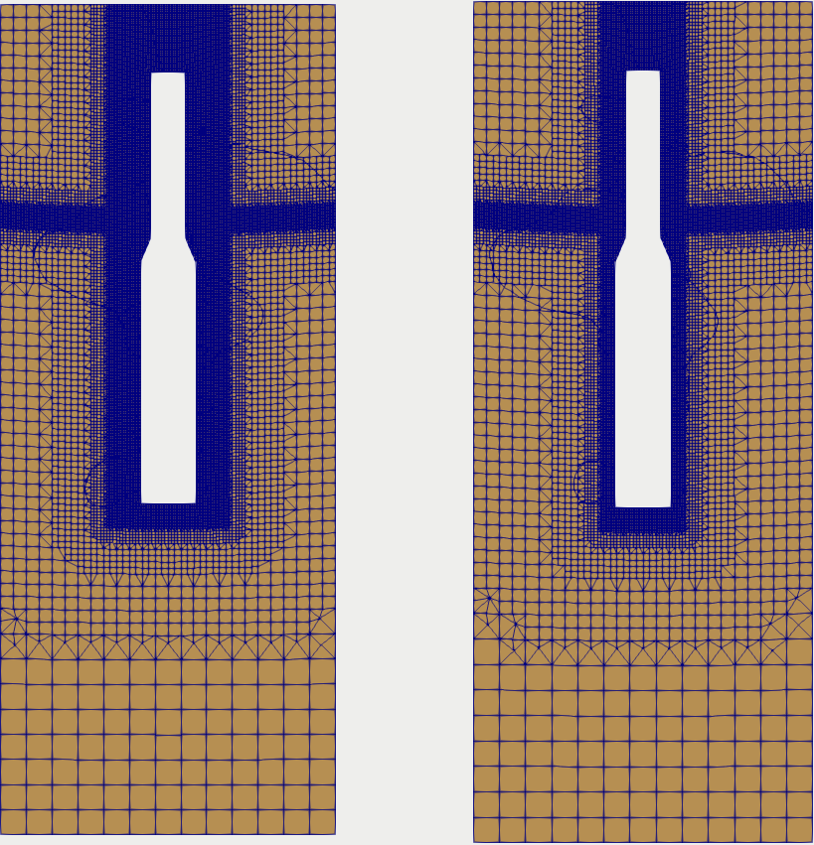
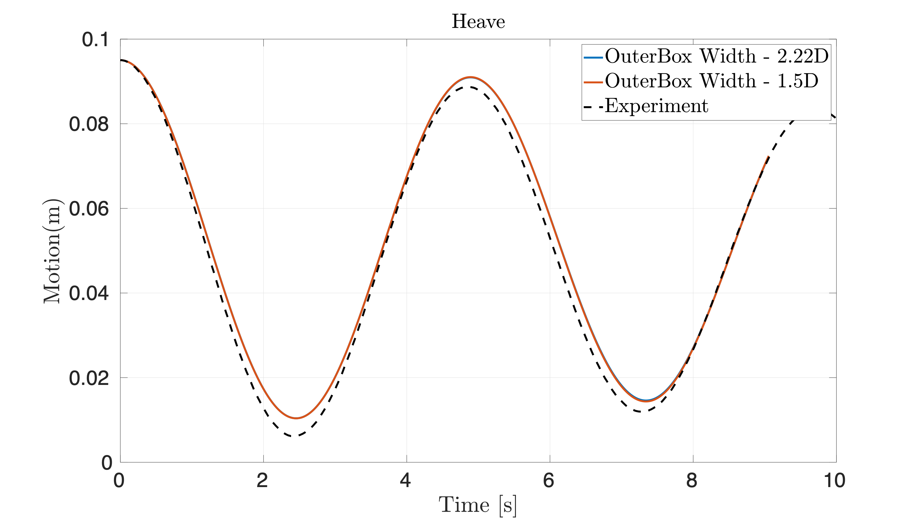
Influence of Width of outer box refinement
2
Picking up the Level 4 refinement in outer Box of width 2D and reducing it to 1.5D and 1D - 35% reduction in cell is achieved
Fig: Heave Free Decay OuterBox Width reduction and its influence is reported
Fig: OuterBox around the SPAR (Left) OuterBox Width 2.22D and (Right) OuterBox Width 1.5D

Slide 17
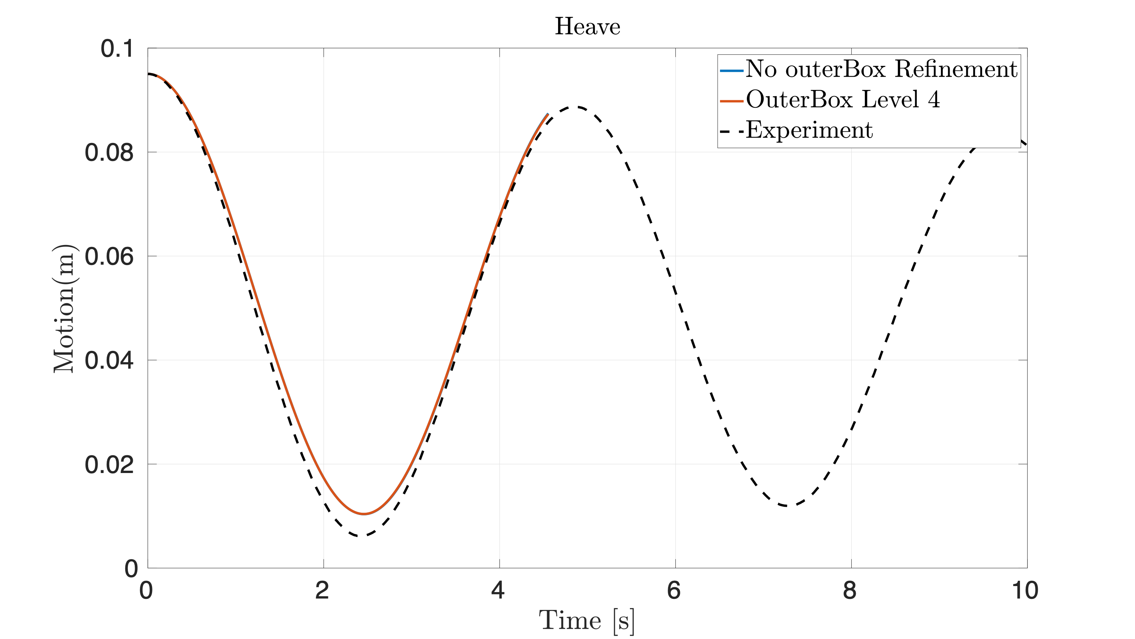
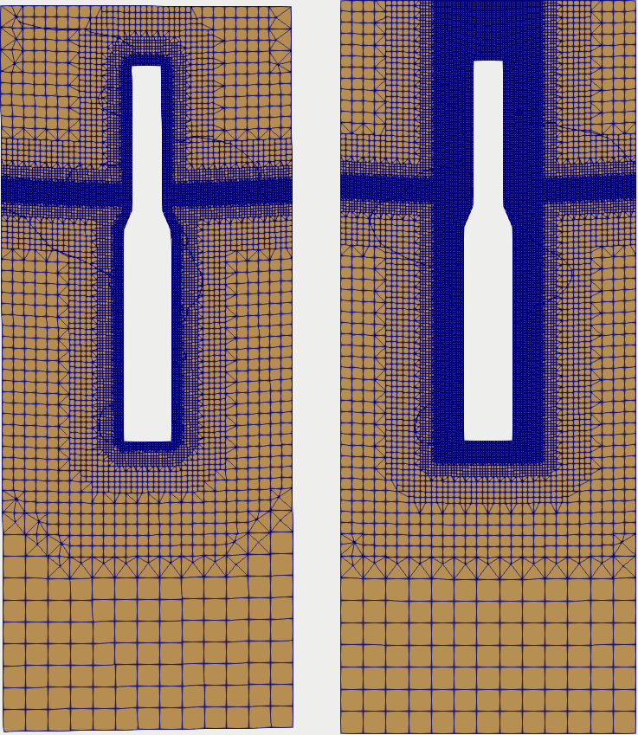
Influence of outer box refinement
2
Picking up the Level 4 refinement in outer Box of width 2D and comparing with No outerBox - 60% reduction in cell is achieved
Fig: Heave Free Decay OuterBox Width reduction and its influence is reported
Fig: OuterBox around the SPAR (Right) OuterBox Width 2.22D and (Left) No OuterBox

Slide 18
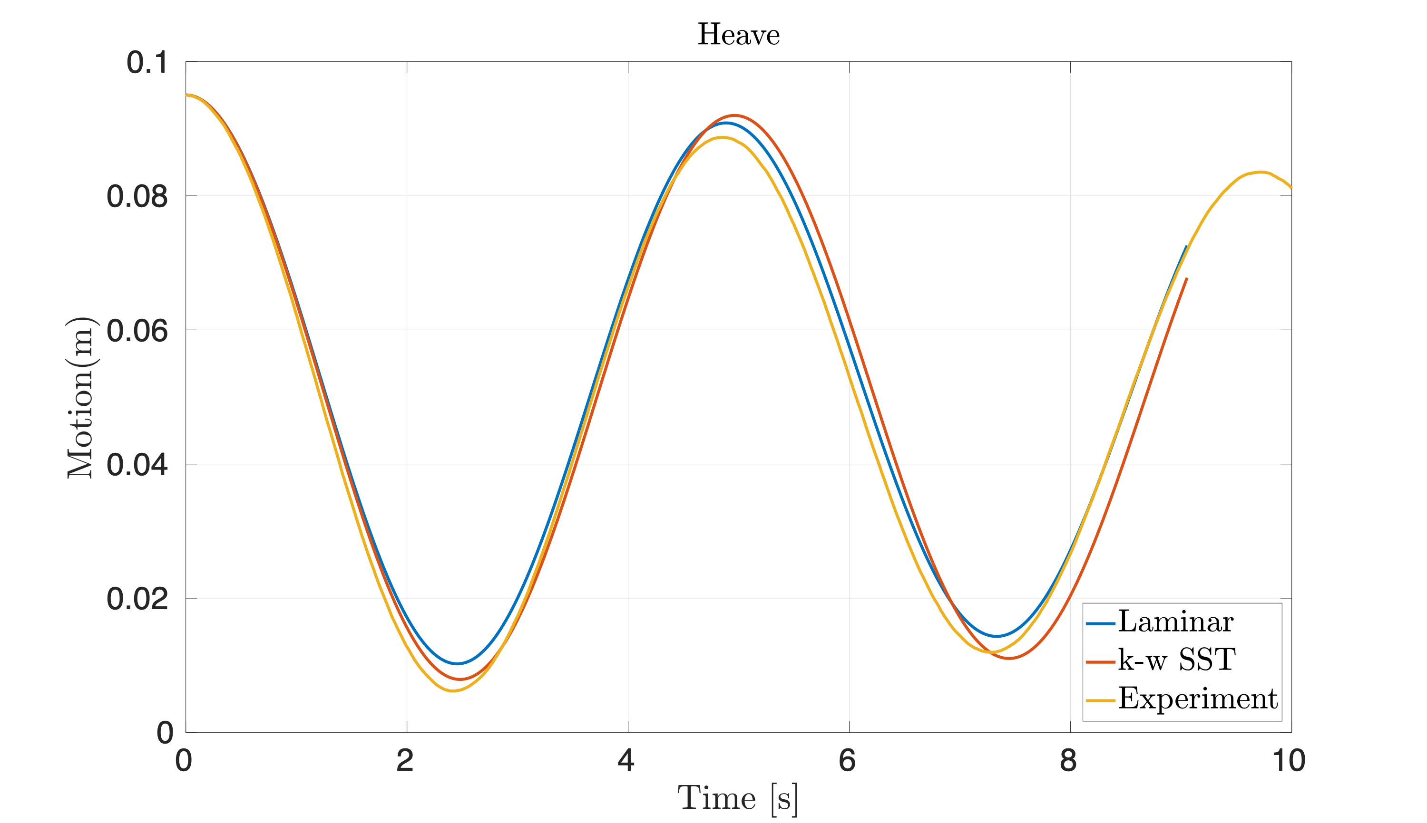
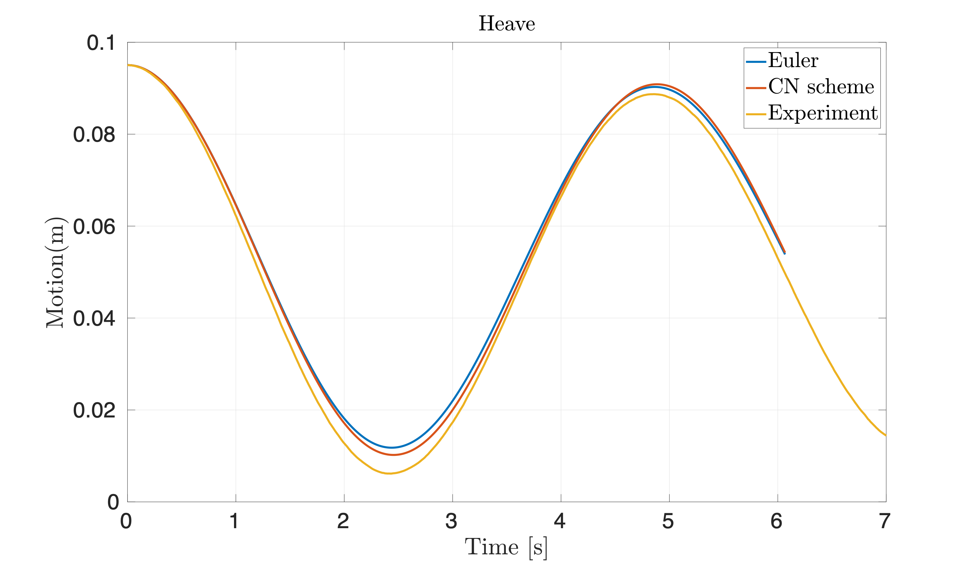
Parametric study
Fig: Comparison of Turbulent model ($k-ω$ SST model) Vs Laminar model
Turbulent model in fact decreases the damping and increases the natural period by a fraction
Fig: Comparison of Time scheme between Euler and CN scheme. Euler scheme damps more than CN (but the difference between 1%)

Slide 19
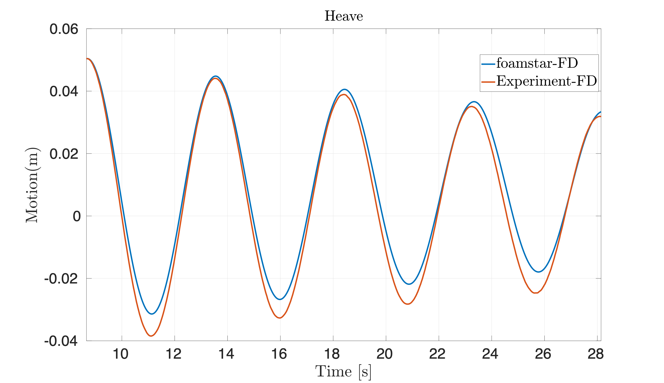
Heave Free Decay
Right side Figure - Result of Heave Free Decay from the mesh setup PPSD 35 discussed earlier
Only for observers convenience it is generalised as foamstar-FD (still the results can be improved)
There is a discrepancy in the results and hence parametric studies are carried out to identify the problem
TestCase | Experiment | ANSYS AQWA | foamStar(upto Now)
Natural period(s) | 4.84 | 4.8 | 4.85
Damping | 1%-2% | 0.01% (Radiation) | 2-2.25%

Slide 20
Forced Oscillation
To investigate the influence of added mass and damping in the system - forced oscillation result resembling the radiation in potential problems is tested
As a starting setup only range of frequency tested are around the natural frequency of the SPAR (1.3 rad/s ) and amplitude also maintained as same as free decay setup initial amplitude (0.045m)
Still complete results are not analysed - shown one of the results measured in natural frequency

Slide 21
Next steps…..
From the parametric studies further refinement level on the SPAR can be improved to Level 5 (keeping number of cells in the range of 1.5- 2 million cells)
More accurate study about damping (Viscous) influence from CFD
Detailed forced oscillation study
Turbulence models
Outer refinements
Influence mooring on Heave FD to be studied (Quasi static and MoorDyn)

Slide 22
Pitch Free Decay

Slide 23
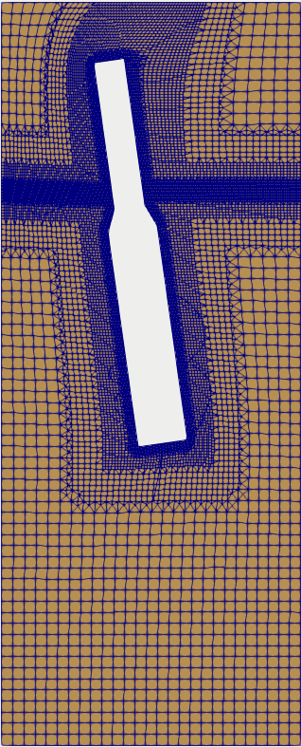
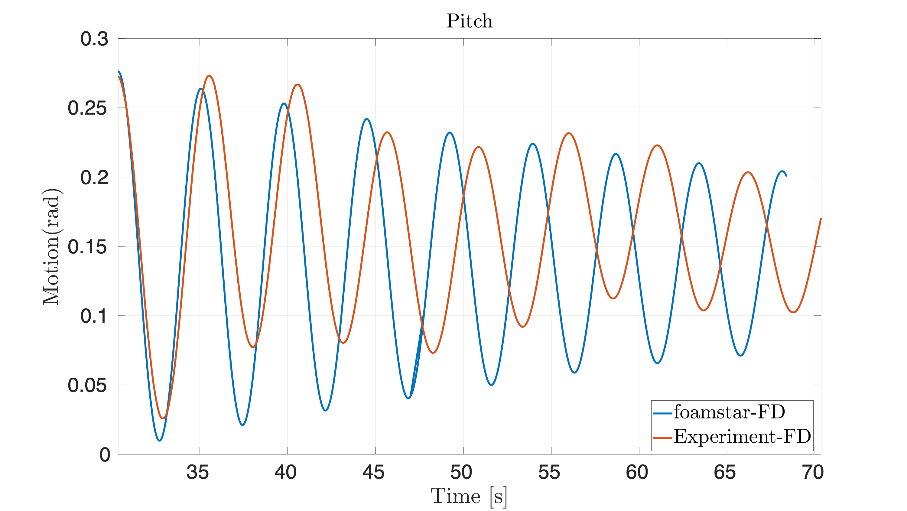
Current status
Heave Free Decay model set up is used here as first simulation on Pitch
Issues
Co spiked from 0.1 to 1.5
Pitch is strongly coupled with Surge
Distortion of cells is higher than Heave Freedecay
Co number has high influence on Natural period(learnt from Heave FD case)- So need very small time step increasing days of simulation further
Surge restoring force also has to be developed to act as initial condition of this Free decay test
Fig : Pitch Freedecay in comparison with Experiment
TestCase | Experiment | foamStar(upto Now)
Natural period(s) | 5.05 | 4.6
Damping | 1.5% | 0.7%
Fig : SPAR with initial rotated position in foamStar

Slide 24
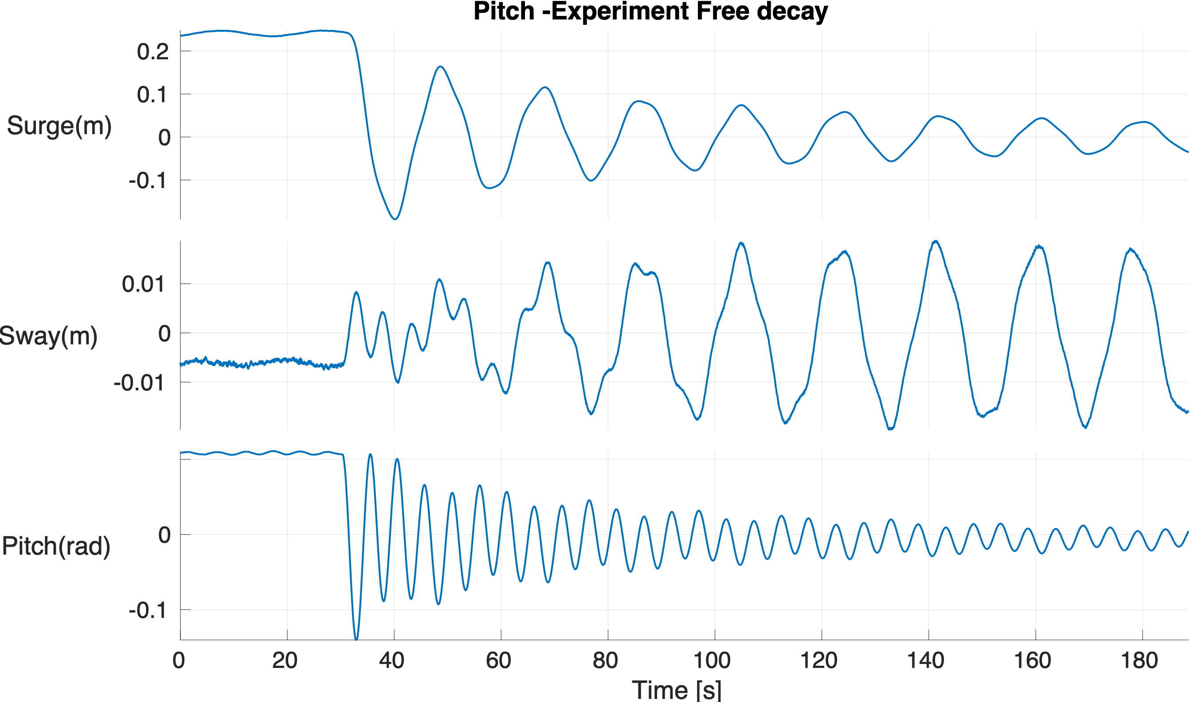
Planned things
Pitch Experiment Free Decay on right shows the influence of surge in Pitch free decay test
Development of giving initial condition not only to pitch also to surge (Spring code is little updated such that restoring started along with Pitch restoring)
Parametric study on Pitch FD to be carried out to see to reduce the number of cells such that quicker solution
AQWA results will be compared if required forced oscillation test will be carried out to see the influence of model in Added Mass Moment of Inertia and Radiation damping
Fig : Experimental Pitch Free Decay motion response

Slide 25
Development of Surge Free Decay

Slide 26
Modification of Mooring Stiffness matrix
Current mooring Stiffness matrix implemented (assuming linear stiffness )
$$F=-Kx$$
Stiffness coefficient is obtained from experimental force or ORCAFLEX model
Modification 1 : To do surge free decay test (Pull out test) - Initial stretched and unstreched length to be implemented modifying the $Δx$ (Validation going on)
$$F=-K(x_{0}-x)$$
Modification 2 : Also since the mooring stiffness matrix is assumed like spring - to modify it terms of mooring, introducing damping terms
$F=-KΔx-dΔx$
($ifΔx<0$ - Negative motion then coefficient only will be activated instead of stiffness) - Still trying to validated the coefficient - I expect the influence will be small in dynamic response but it will be important for very long cables and large values of relative velocity

Slide 27
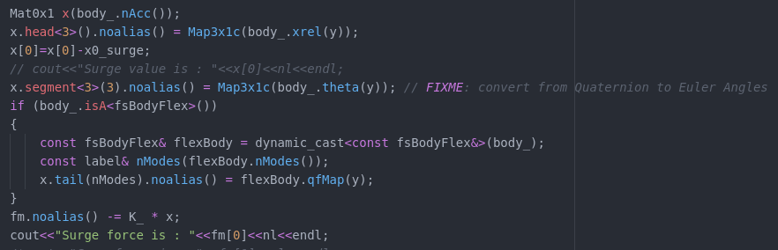
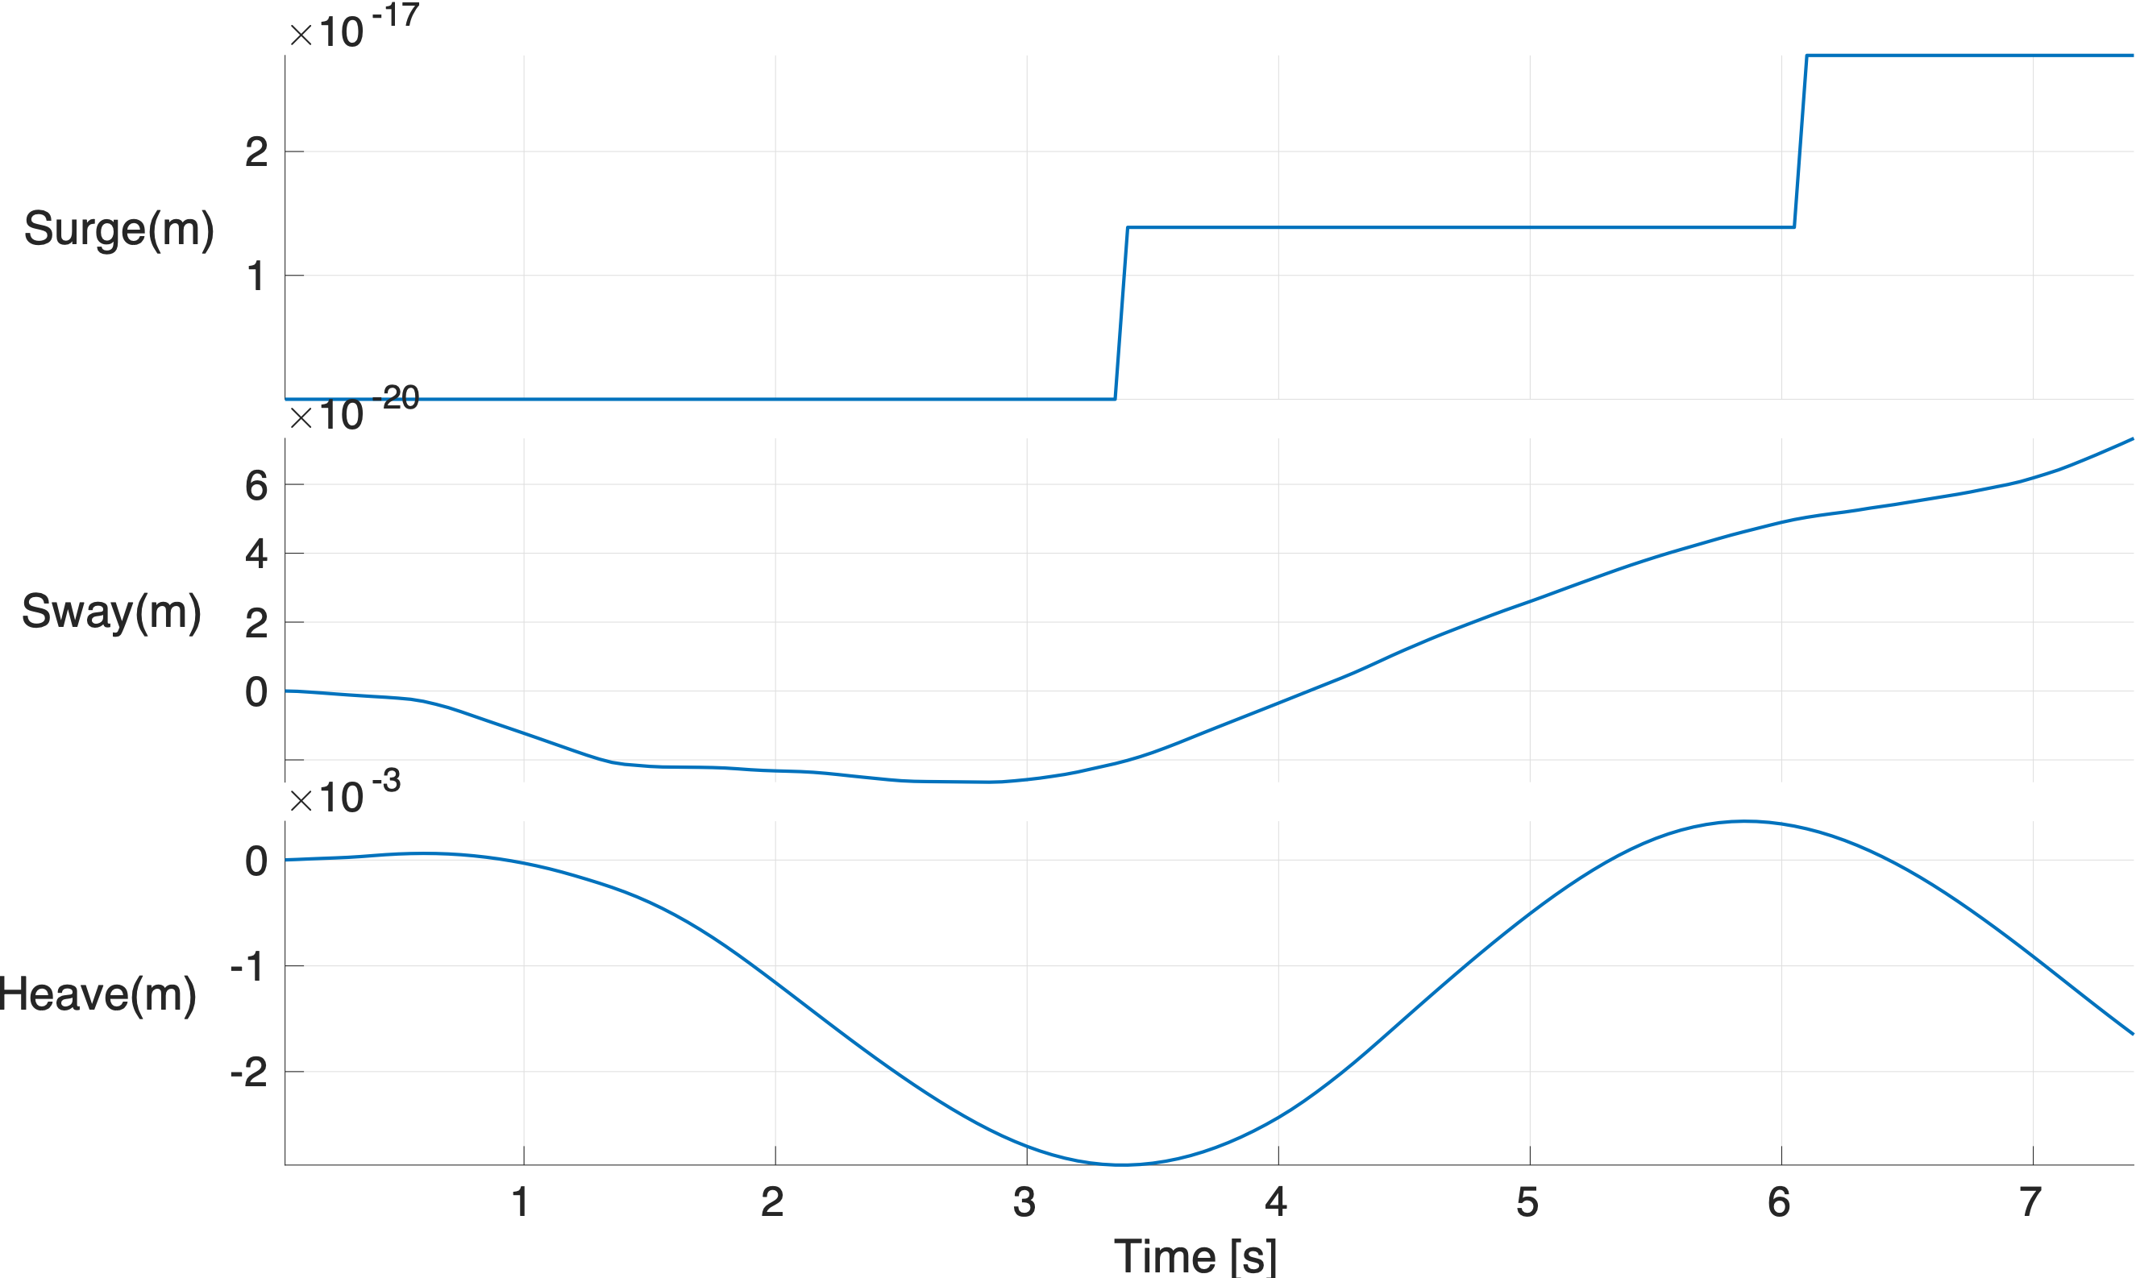
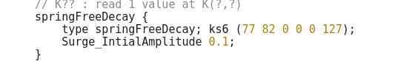
Modification of Mooring Stiffness matrix
Modified the code snippet as given below
Still issues are there as the restoring force is not bringing the SPAR quickly
Still work to be done!!
Fig : Code snippet for Spring Stiffness modified with Initial amplitude
Fig : foamStar dynamicMeshdict snippet for Initial amplitude

Slide 28
SWENSE equations for Free Decay

Slide 29
Governing Equation
General SWENSE equation for Two phase problem
$\frac{∂ρu_{C}}{∂t}+∇.(ρuu_{C})+ρu_{C}∇.u_{I}=-∇p_{C}+∇.(μ(∇u+∇u^{T}))+\frac{p_{I}}{ρ_{I}}∇ρ$
For Free Decay Test - Incident wave velocities $(u_{I}=0)$ and Incident pressure will be static pressure, Hence parameters becomes
$$u=u_{I}+u_{C}=u_{C},p_{C}=p_{ρgh}$$
(Skipped Derivation for presentation)Final equation becomes
$\frac{∂u}{∂t}+u.∇u=-\frac{∇p_{ρgh}}{ρ}+\frac{∇.(μ(∇u_{C}+∇u_{C}^{T}))}{ρ}+gz\frac{∇ρ}{ρ}$
Hence for Free Decay test SWENSE is identical to two phase NS equation - Hence SWENSE should create same results like foamStar. Also SWENSE solver can be validated but no advantage of SWENSE can be achieved with Free Decay results

Slide 30
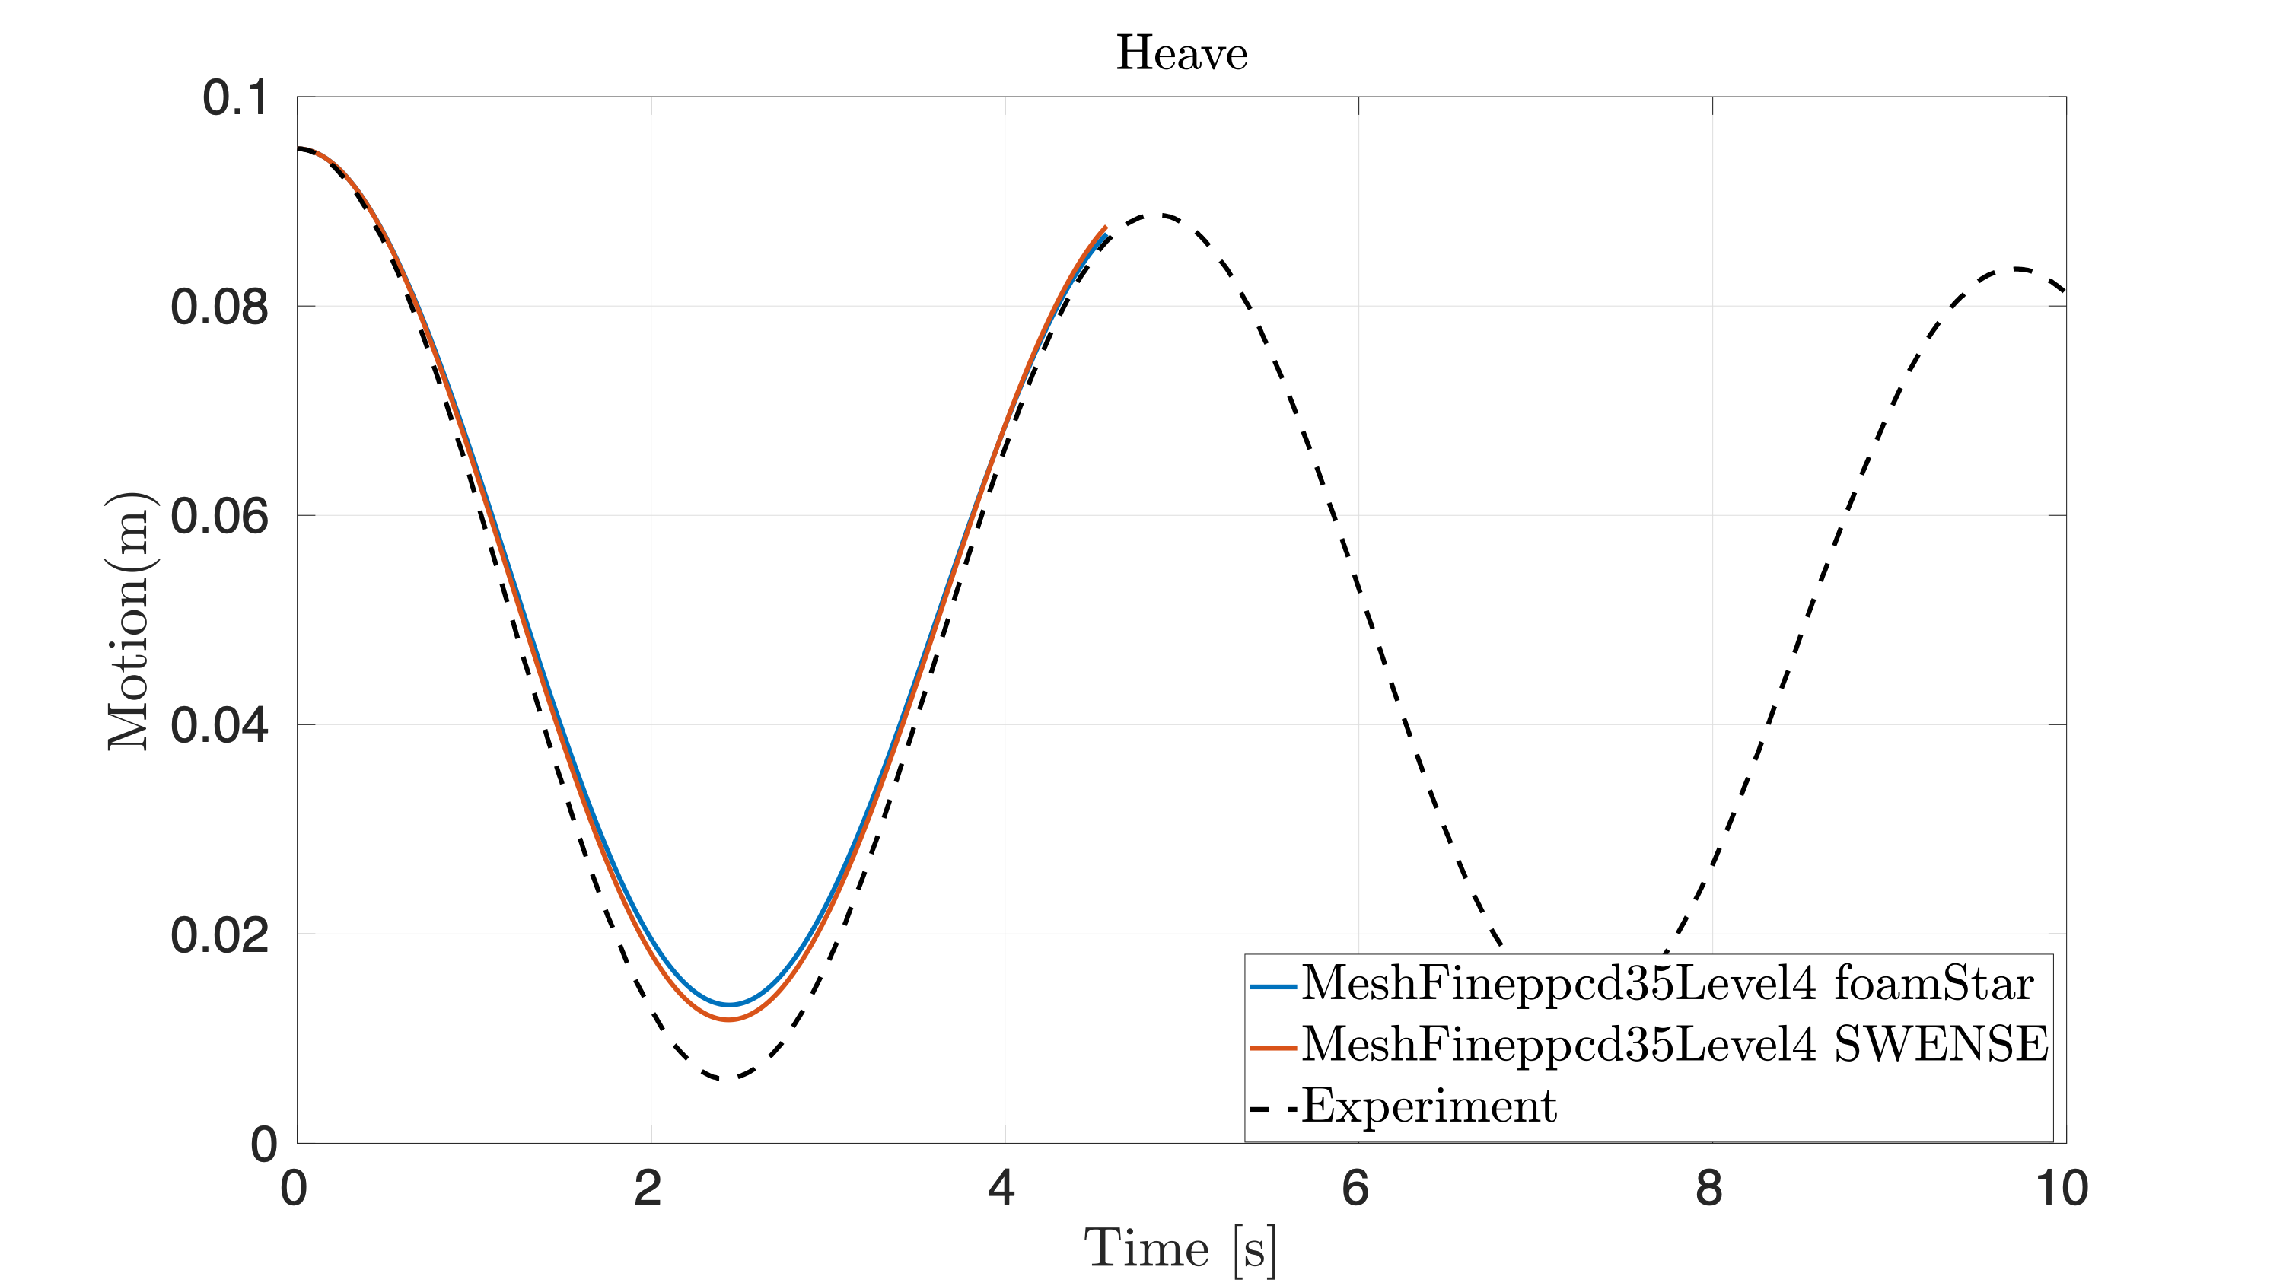
HEAVE FREE DECAY COMPARISON
Since the outer box has no influence in the PPCD - Influence of outer boxes are tested with the problem of Heave Free Decay motion
FS Refinement involved refining 1 and 2 in the same ratio
It seems that refinment has an influence on damping values obtained in the simulation (higher refinement has better results in terms of damping)

Slide 31
SPAR in presence of regular Wave

Slide 32
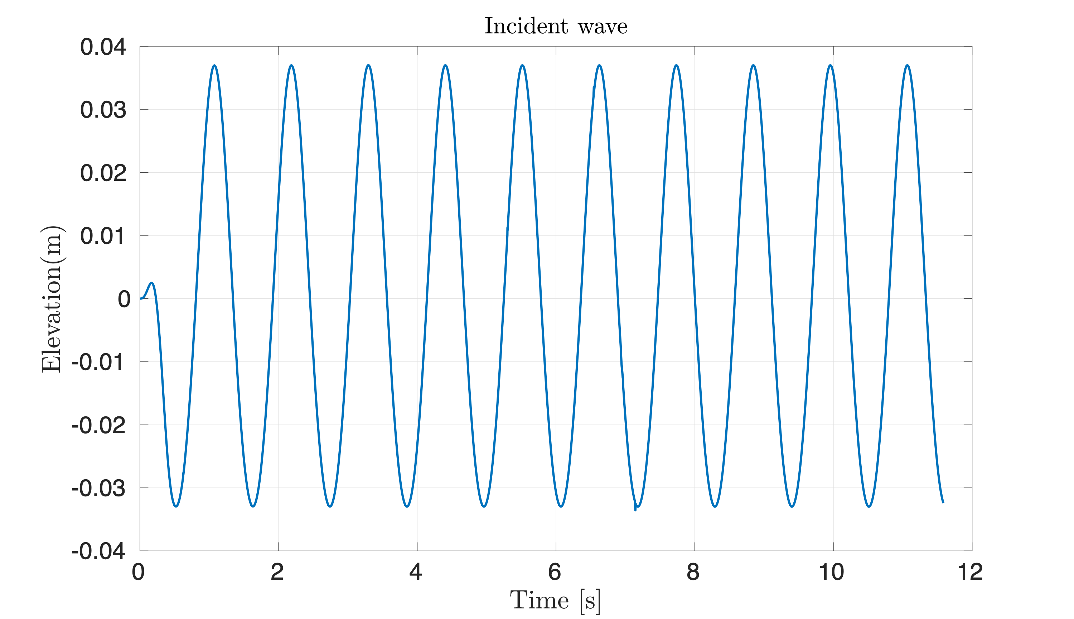
Wave validation in domain
Regular wave : A 0.035m and T 1.11s
Experimental Run time : 100s
Domain maintained: Same shortest domain
Fig: Incident Wave validation with input parameters using wave probe placed inside the domain

Slide 33
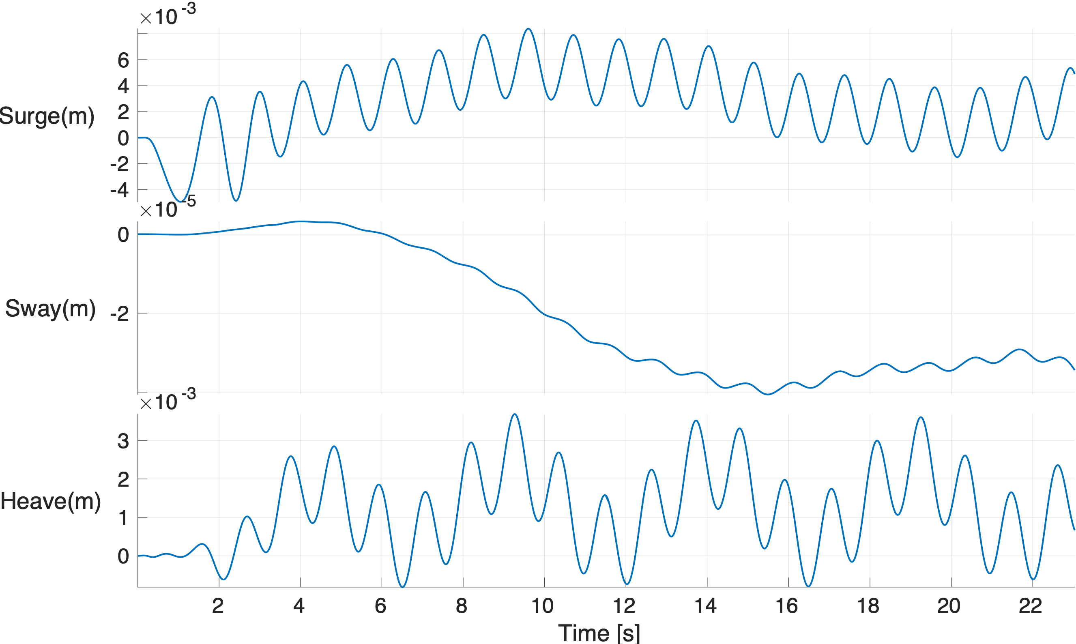
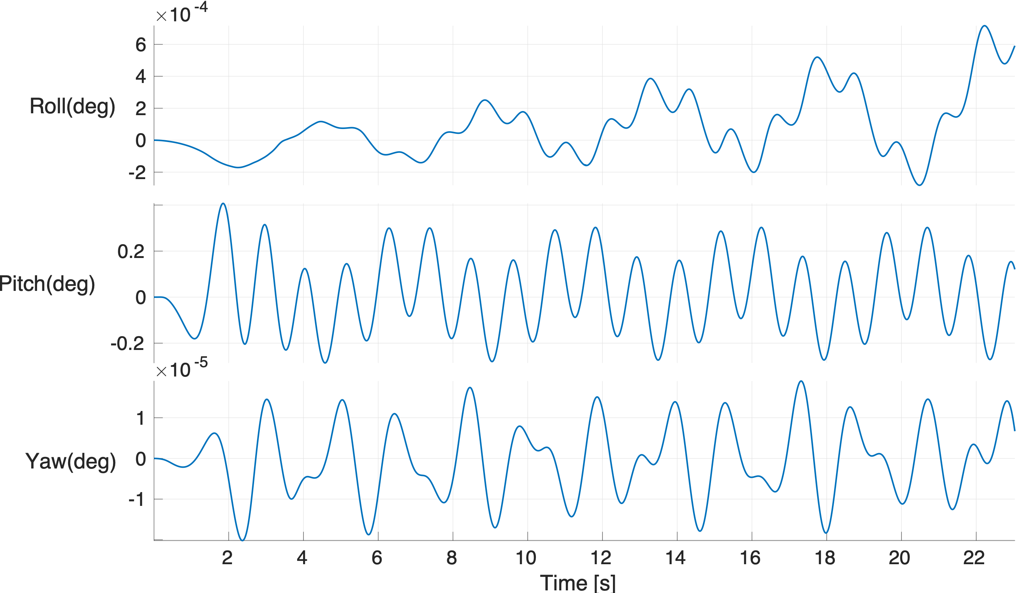
Complete Motion recorded

Slide 34
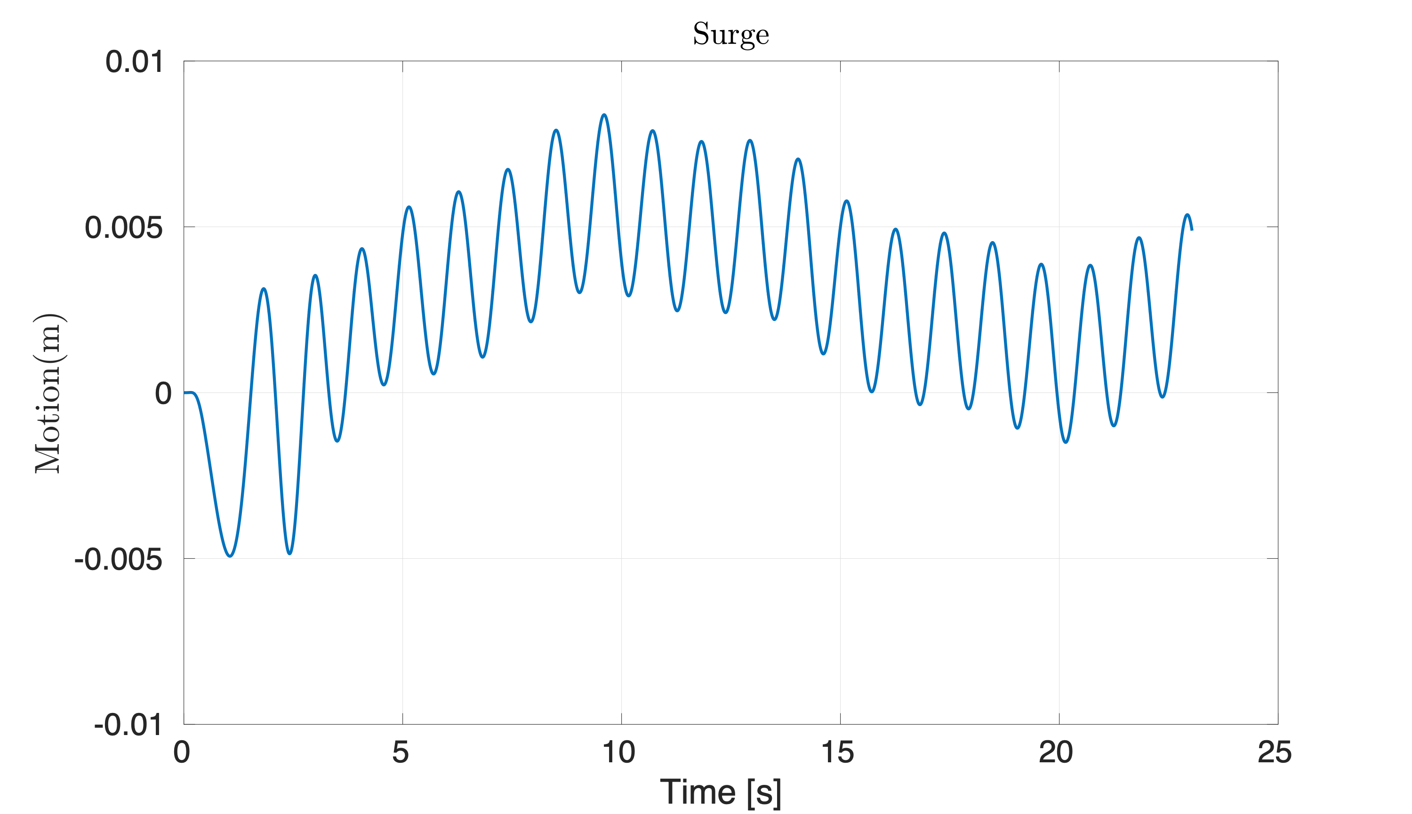
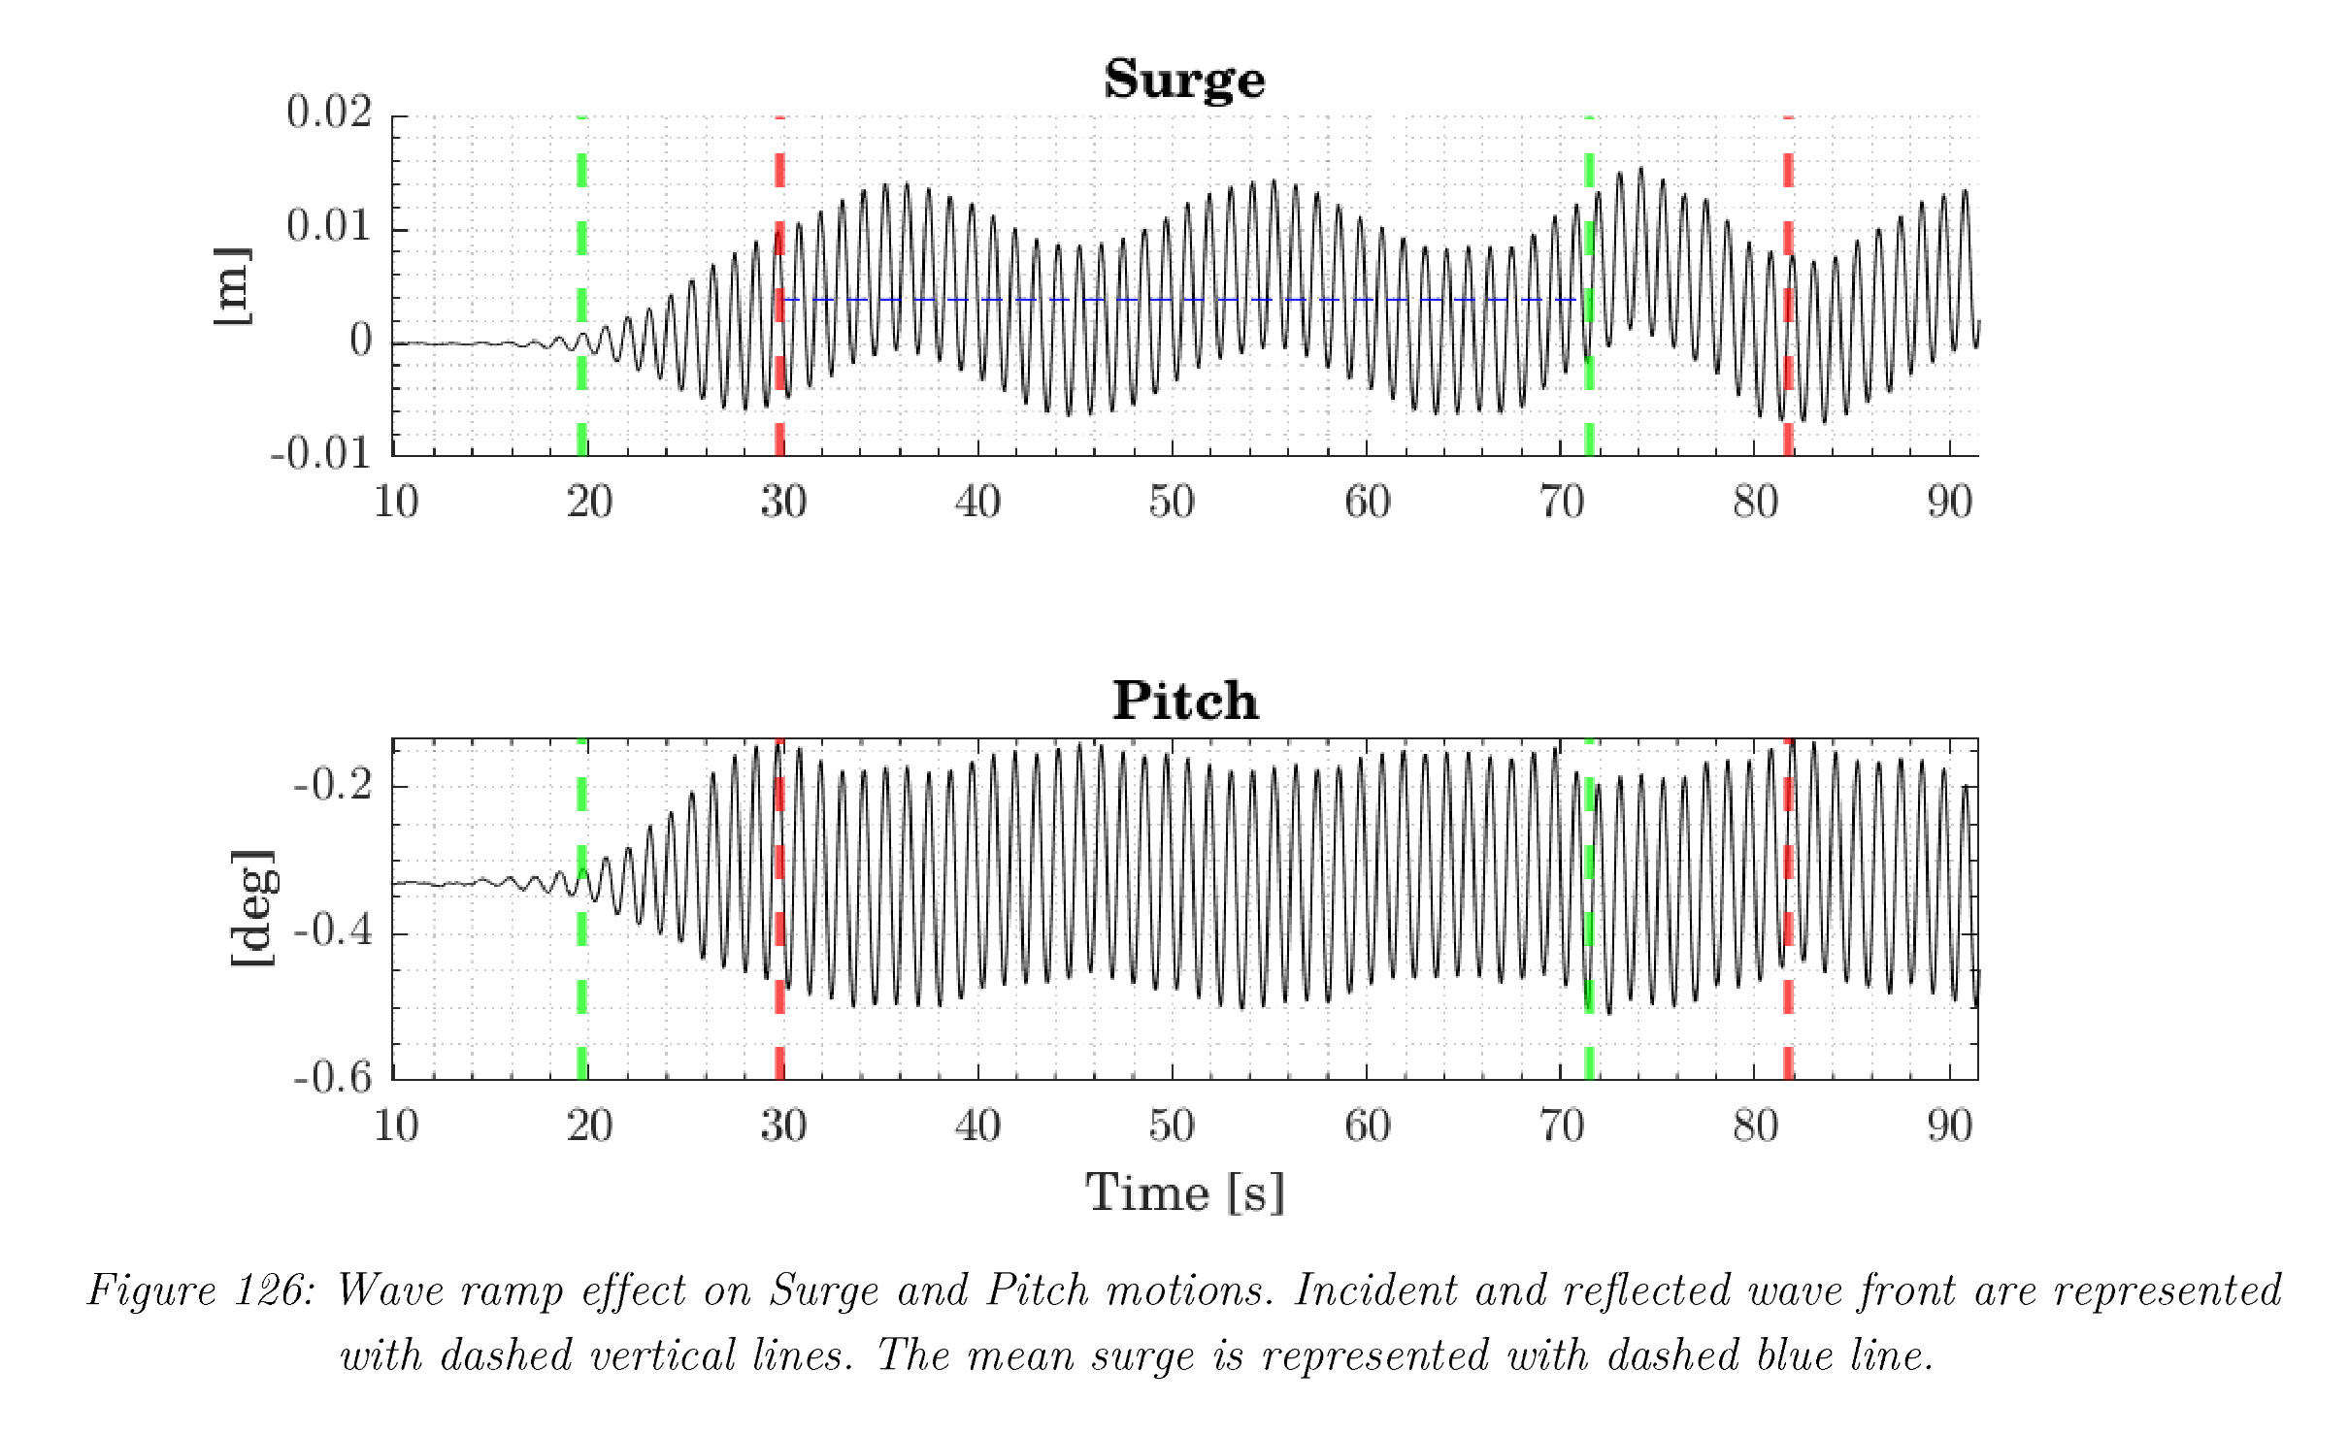
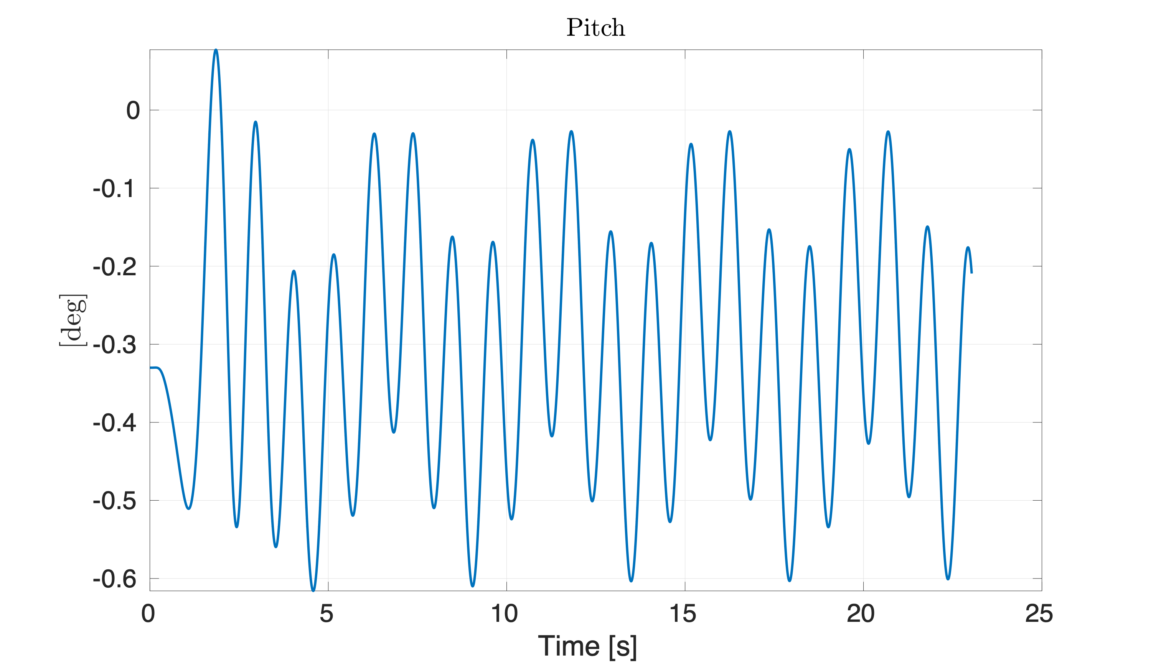
Comparison
Fig: foamStar results on left side and Experimental results on right side

Slide 35
Next steps…..
Pitch motion accuracy from Free Decay to be brought in this case
Surge amplitude appears 20% less compared to Experiment results

Slide 36
SPAR in presence of Irregular Wave

Slide 37
Test cases in Experiment
Using Froude scale modelling for site data (1:40 Model)- Wave height and Time period parameters are scaled
Spectrum chosen is Bretschneider spectrum
$$S(f)=\frac{5}{16}H_{s}^{2}f_{m}^{4}f^{-5}exp\left[-\frac{5}{4}{\left(\frac{f}{f_{m}}\right)}^{-4}\right]$$
Using HOS - NWT (ECN Wave basin set up) the input waves for foamStar/SWENSE is generated and validated
Scale 1:40 | SITE |  | MODEL
Type | Hs(m) | Tp(s) | Hs(cm) | Tp(s)
Normal sea | 0.8 | 7 | 2 | 1.11
Normal sea | 1.9 | 7.8 | 4.75 | 1.23
Normal sea | 5.8 | 10.9 | 14.5 | 1.72
Severe sea | 7.7 | 12.4 | 19.25 | 1.96
Severe sea | 7.7 | 12.4 | 19.25 | 1.96
Severe sea | 10.9 | 15 | 27.25 | 2.37
Table : Testcases carried out it in Experiment and its Froude scaled Wave height and time period
* Chosen Test cases

Slide 38
Outcome so far
Up to date results have so far!! - OpenPDF

Slide 39
Coupling with MoorDyn Mooring solver

Slide 40
MoorDyn
Lumped mass method involves lumping effects of mass, external forces, and internal reactions at a finite number of points(nodes) along the mooring line
Functions
Initialisation : Reads Input file and act as Quasi static model and use dynamic relaxation as per MoorDyn (if there is a connect node)
Calculation/Coupling : Accepts floater motion and estimates fairlead nodes updated position (it adjusts its internal time step size based on coupling time step size) and returns resulting net mooring force to the calling program
Termination : MoorDyn deallocates variables and closes the output files.

Slide 41
Development in terms of MoorDyn
Main code in C++ is generated to validate MoorDyn alone for different cases (Only body motions and mooring arrangement to be givens input)
To visualise the MoorDyn output - Matlab conversion code is created to convert the .out format in MoorDyn to .vtp format in Paraview
Also to match the time domain simulation of any floating body - another Matlab program is created to convert .vtp to .pvd (Paraview data) format - such that it matches its motion in time with any floating body motion
Coupling with foamstar is in place and expect to complete soon

Slide 42
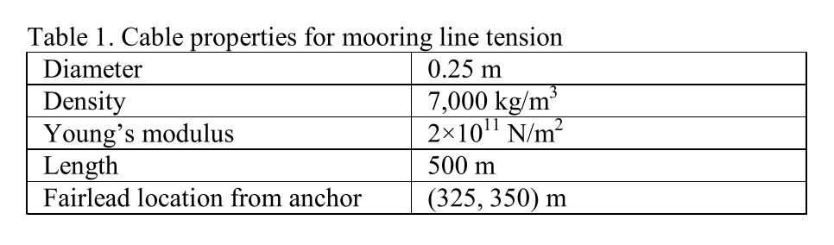
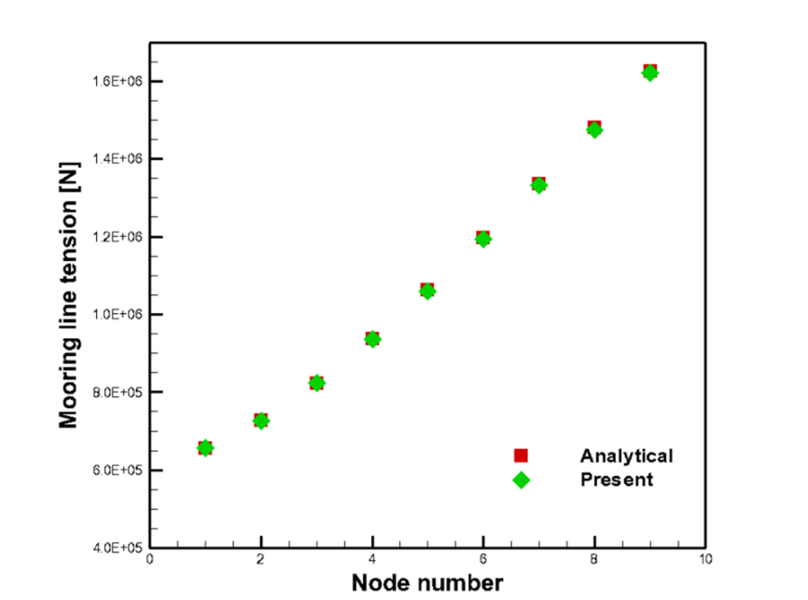
Validation 1 : Simple Catenary shape
Analytical solution of single catenary mooring line (Irvine, 1981)

Slide 43
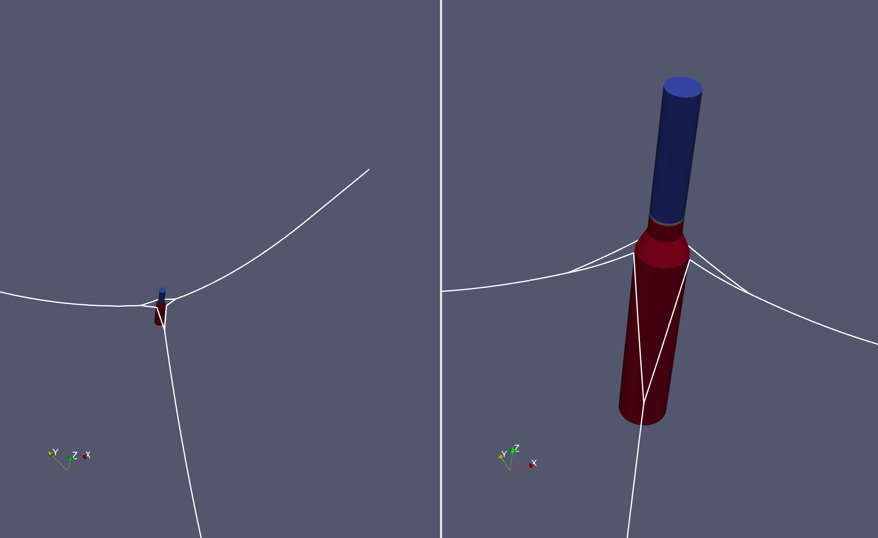
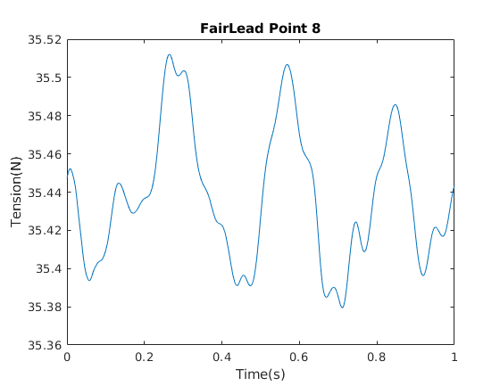
Validation 2 : SPAR test cases
In current SPAR test case , 3 catenary lines with Bridle arrangement forming 6 fairlead points
Hydrostatic test case of SPAR is tested for 10s in the MoorDyn (alone) and mooring force are stable
Fig : Mooring line visualised in Paraview with body (Still not coupled - Just shown for working of MoorDyn)
Fig: Sample Fairlead forces measured - still oscillation can be controlled with proper damping input values

Slide 44
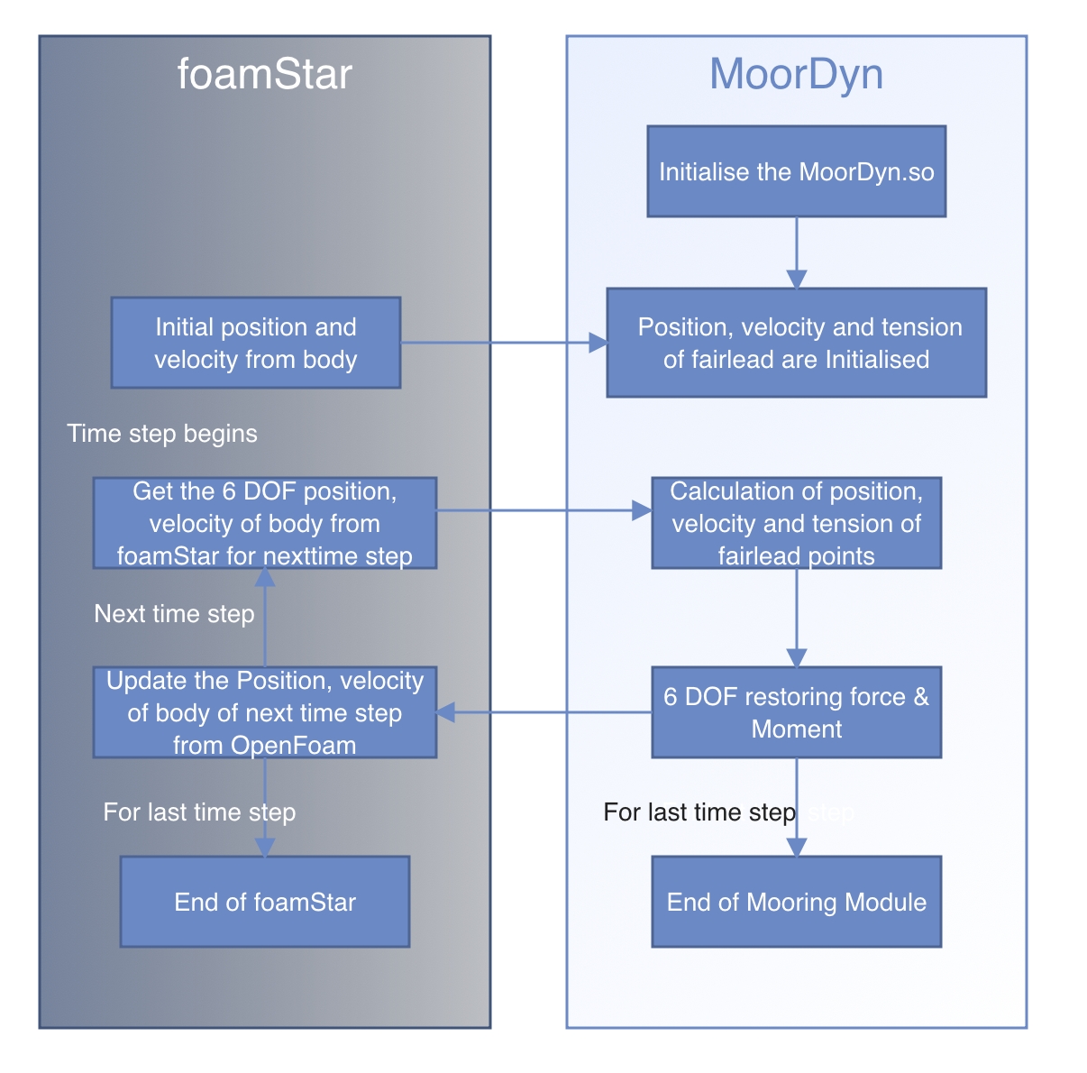
Coupling with foamstar
Coupling will be based on loose coupling approach
At each time step, data are transferred bi-directionally at the interface. 6-DOF displacement and velocity of the platform, current time, and time step size are transferred from foamStar to Moordyn as the input of MoorDyn.
Then MoorDyn calculates the fairlead tension and restoring forces, and the restoring forces are transferred to foamStar as external restraint forces of the 6-DOF rigid body motion of the platform.
Issues:
MoorDyn is not stable with iterating with same time step (say 0.01 to 0.02s) multiple times
Hence coupling is made such that only for first PIMPLE iteration MoorDyn will be called for forces and that forces will be maintained same until next PIMPLE iteration (avoiding multiple iterations)
Fig: Flow chart workflow procedure being carried for coupling foamStar

Slide 45
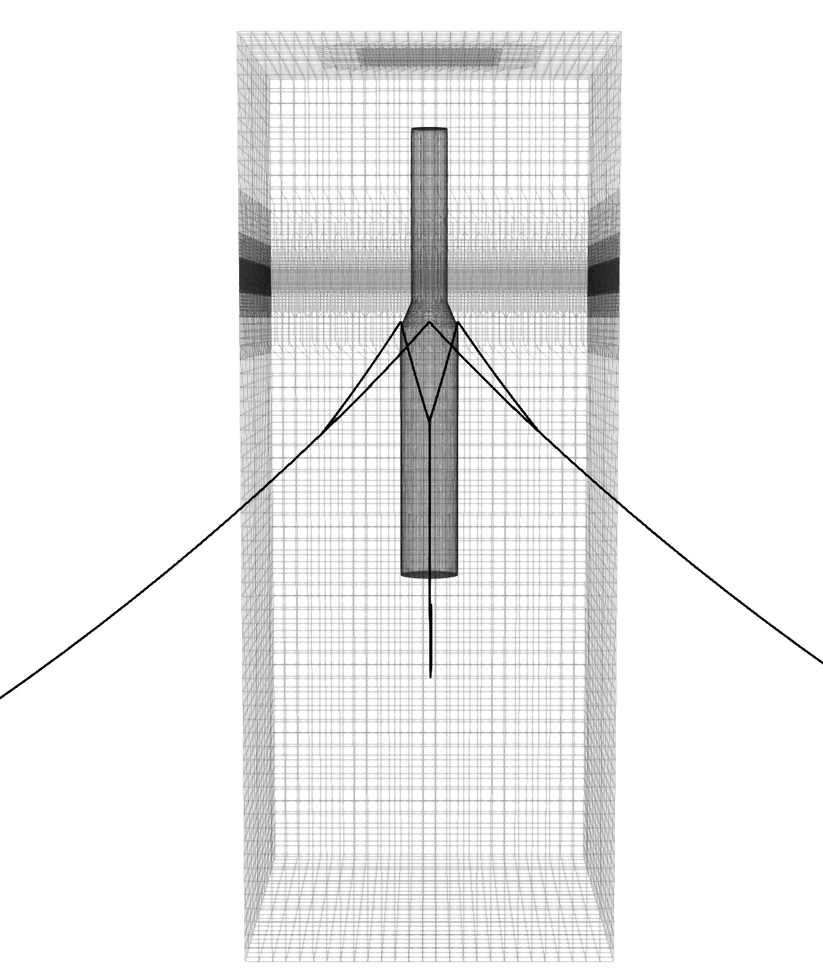
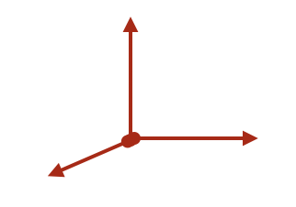
Current status
Z
MoorDyn works on Inertial Frame of reference and body motions from foamstar has to transformed to Inertial Frame of reference and vice versa for mooring forces and moments
Working in this setup and expected to validate the model soon
Objective
Convert velocities (6 dof) and displacement (6 dot) from Body Frame to Inertial Frame
Convert Forces (6 dof) from Inertial frame to Body frame
X
Y
O
Zb
Yb
Xb
OCOG
Fig: Inertial Frame of Reference (OXYZ) and body Frame of reference ($O_{COG}X_{b}Y_{b}Z_{b}$)

Slide 46
To be done
Complete the coordinate transformation and testing the code!!
If successful validate all the test case above with MoorDyn instead of Spring

Slide 47
Questions for discussion
I wish to complete the PhD within this year 2021
Also ECN compelled to submit thesis in Oct 2021
My objective of my Phd is still not clear - I am adding some minor additions to their code (no major changes) and validating with different applications (fixed and floating cases).
Completing this am I eligible for PhD sir?
Do I have to do any extra new things to complete the PhD ?
As per IITM guidelines, What should I do complete the PhD within this year sir?

Slide 48
